Slide 1

Prof . V.B. Shah Institute of Management & R. V. Patel College of Commerce
(Eng. Med.) & V. L. Shah College of Commerce (Guj. Med.) &
Sutex Bank College of Computer Applications & Science, Amroli
(Accredited ‘B’ (CGPA 2.55) by NAAC Dec.-2009)
VEER NARMAD SOUTH GUJARAT UNIVERSITY, SURAT
Major Project Report
FOR THE DEGREE OF
Bachelor of computer application
(B.C.A 6th SEMESTER)
YEAR: 2024-25
: Submitted By :
Archi Patel | Disha Rabari | Alvi Kadivar
Rinkal Paramar | Sneha Ramani | Vaibhavi Chotaliya
: Guided By :
Ms. Aayushi S. Suratwala

Slide 2
Project
Management
System

Slide 3
Agenda
1
Introduction
2
Environment Description
3
Proposed System
4
Detail Planing
5
System Design
6
Drawbacks
7
Future Inhencement
8
Reference

Slide 4
1. Introduction
1.1 Project Description
1.2 Project Profile

Slide 5
1.1 Project Description
A Project Management System (PMS) is a web-based application designed to streamline project handling, task allocation, and team collaboration.
It provides a structured framework that connects Admins, Clients,Teamleader, Developers, and Testers, ensuring effective communication and efficient project execution.
By automating workflows and tracking progress, PMS enhances productivity, minimizes errors, and helps complete projects on schedule.
The main purpose of PMS is to offer a unified platform where users can efficiently plan, execute, and monitor projects.
The system reduces manual efforts, ensures transparency, and facilitates real-time project tracking. With well-defined roles and access control, each user can focus on their specific responsibilities, leading to improved efficiency and accountability.

Slide 6
1.2 Project Profile
Project Profile | Description
Project name | Project Management System
Organazation | Sutex Bank College Of computer Applications And Science,Amroli
Backend Technology | PHP,AJAX
Frontend Technology | HTML,CSS,Bootstrap4,Javascript
Database | MySql
Operating System | Window 10
Documentation Tool | Microsoft Word
Browser | Chrome,Opera,Edge
Internal Guide | Asst.Prof.Ms.Ayushi Suratwala
Submitted To
Developed By | Archi Patel Disha Rabari Sneha Ramani Alvi Kadivar Rinkal Parmar Vaibhavi Chotaliya

Slide 7
2. Environment Description
2.1 Hardware and Software Requirment
2.2 Technology Used

Slide 8
2.1 Hardware and Software Requirment
Hardware Configuration
Component | Specification
Storage | Minimum 2-4 GB SSD
Devices | PC/Laptop with Windows 10 or 11
Software Configuration
Component | Specification
Frontend | HTML,CSS,Bootstrap4,Javascript
Backend | PHP,AJAX
Database | MySql for Data storage and management
Version Control | GitHub for version control and collaboration
Operating System | Windows 10, Windows 11

Slide 9








2.2 Technology Used
GITHHUB
BOOTSTRAP

Slide 10
3. Proposed System
3.1 Scope
3.2 Project Modules
3.3 Module Vice Objective
3.4 Expected Advantages

Slide 11
3.1 Scope
The Project Management System (PMS) is created to make project planning, task assignment, and tracking easier and more efficient.
It helps teams work together in an organized way by providing a clear structure for managing different project activities.
Centralized Project Management : Keeps all project details, tasks, and progress in one place.
Role-Based Access : Assigns specific roles to Admins, Clients, Project Managers, Developers, and Testers.
Approval Workflow : Ensures structured project validation.
Real-Time Messaging : A built-in chat feature enables seamless communication among team members.
Task and Approval Automation : Reduces manual work by automating assignments and approvals.
Assigns tasks, sets deadlines, and tracks progress.
Bug Tracking System : Helps testers report and developers fix issues efficiently.
Keeps project data safe and organized, using a secure database to store important information.

Slide 12
3.2 Project Modules
Modules
Tester
Teamleader
Admin
Client
Developer

Slide 13
3.3 Module Vice Objective
1. Admin :
Login
Manage Language and Database.
Manage User Roles (Clients, Teamleader, Developers, Testers)
Approve Pending Projects
View Bugs,Client feedback
Generate Reports
Manage Gallery pictures

Slide 14
3.3 Module Vice Objective
2. Client:
Login
Update Password
Update Profile
View Project Progress
Feedback to the admin
Make payment after project completion
Download receipt of payment

Slide 15
3.3 Module Vice Objective
3. Teamleader:
Login
Update Password
Update Profile
View assign Tasks
View Task Progress
Communicate with Team Members
Bug Tracking & Resolution

Slide 16
3.3 Module Vice Objective
4. Developer:
Login
Update Password
Update Profile
View assign Tasks
View Task Progress
Communicate with Team Members
Bug Tracking & Resolution

Slide 17
3.3 Module Vice Objective
5. Tester:
Login
Update Password
Update Profile
Test Assigned Tasks
Communicate with Team Members
Report Bugs
Verify Bug Fixes
Approve Completed Task

Slide 18
3.4 Expected Advantages
Easy to use
User friendly interface
Easy to manage
Report generating feature
Security
Reduce time & effort
Real time messaging and update

Slide 19
4. Detail Planning
4.1 Dataflow Diagram
4.2 Entity Relationship Diagram

Slide 20
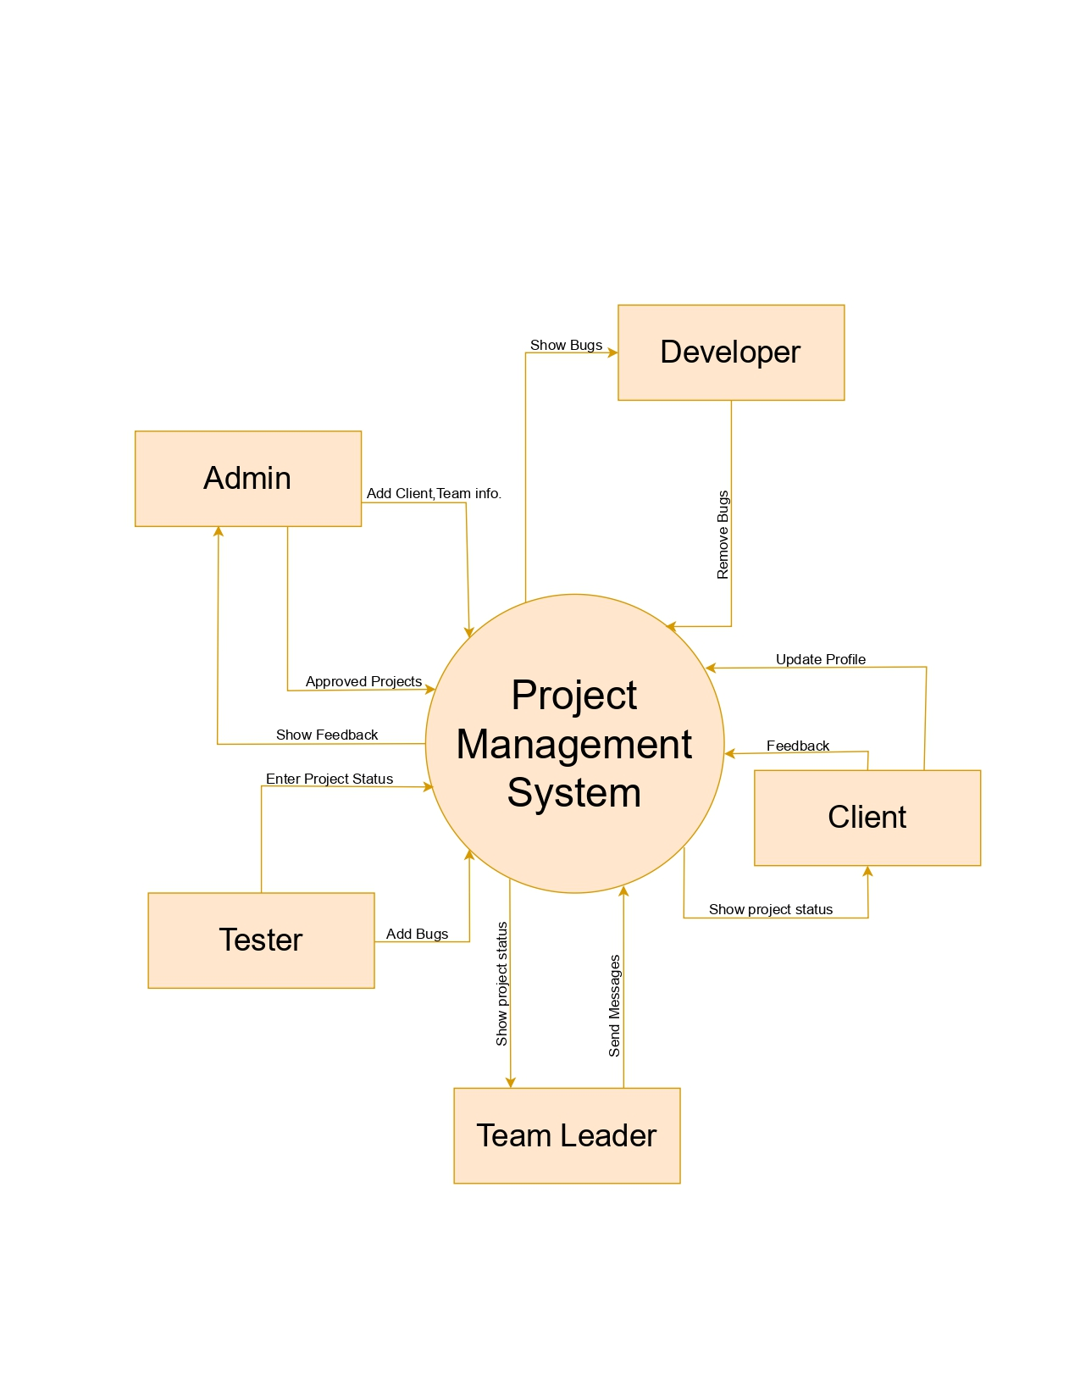
4.1 Dataflow Diagram
Context
Level Diagram

Slide 21
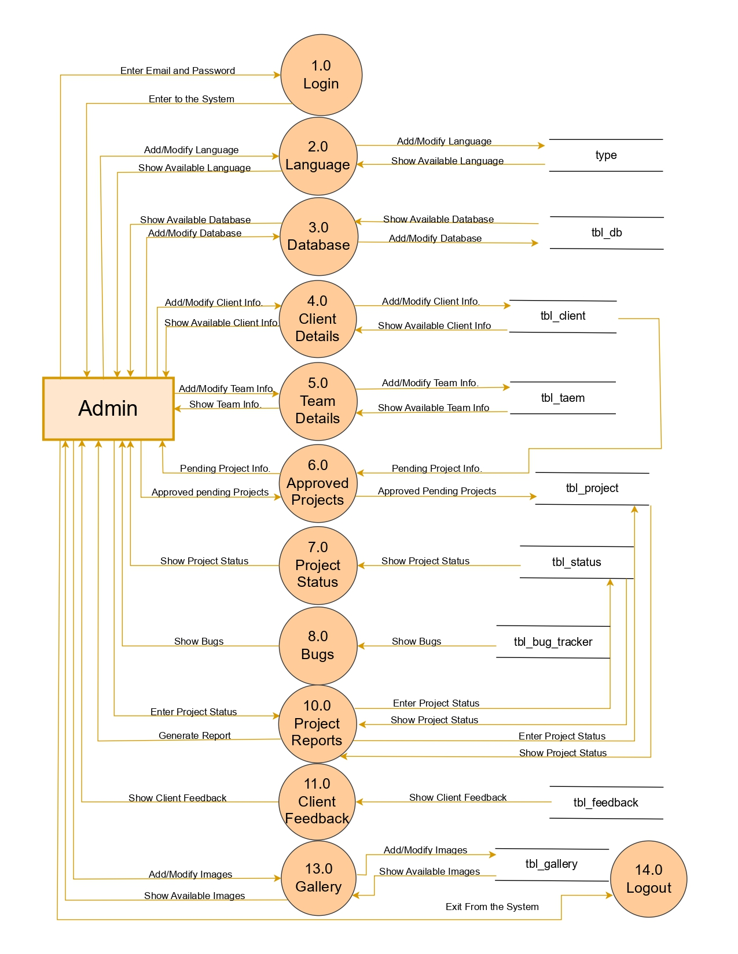
1st Level
Admin
Diagram

Slide 22
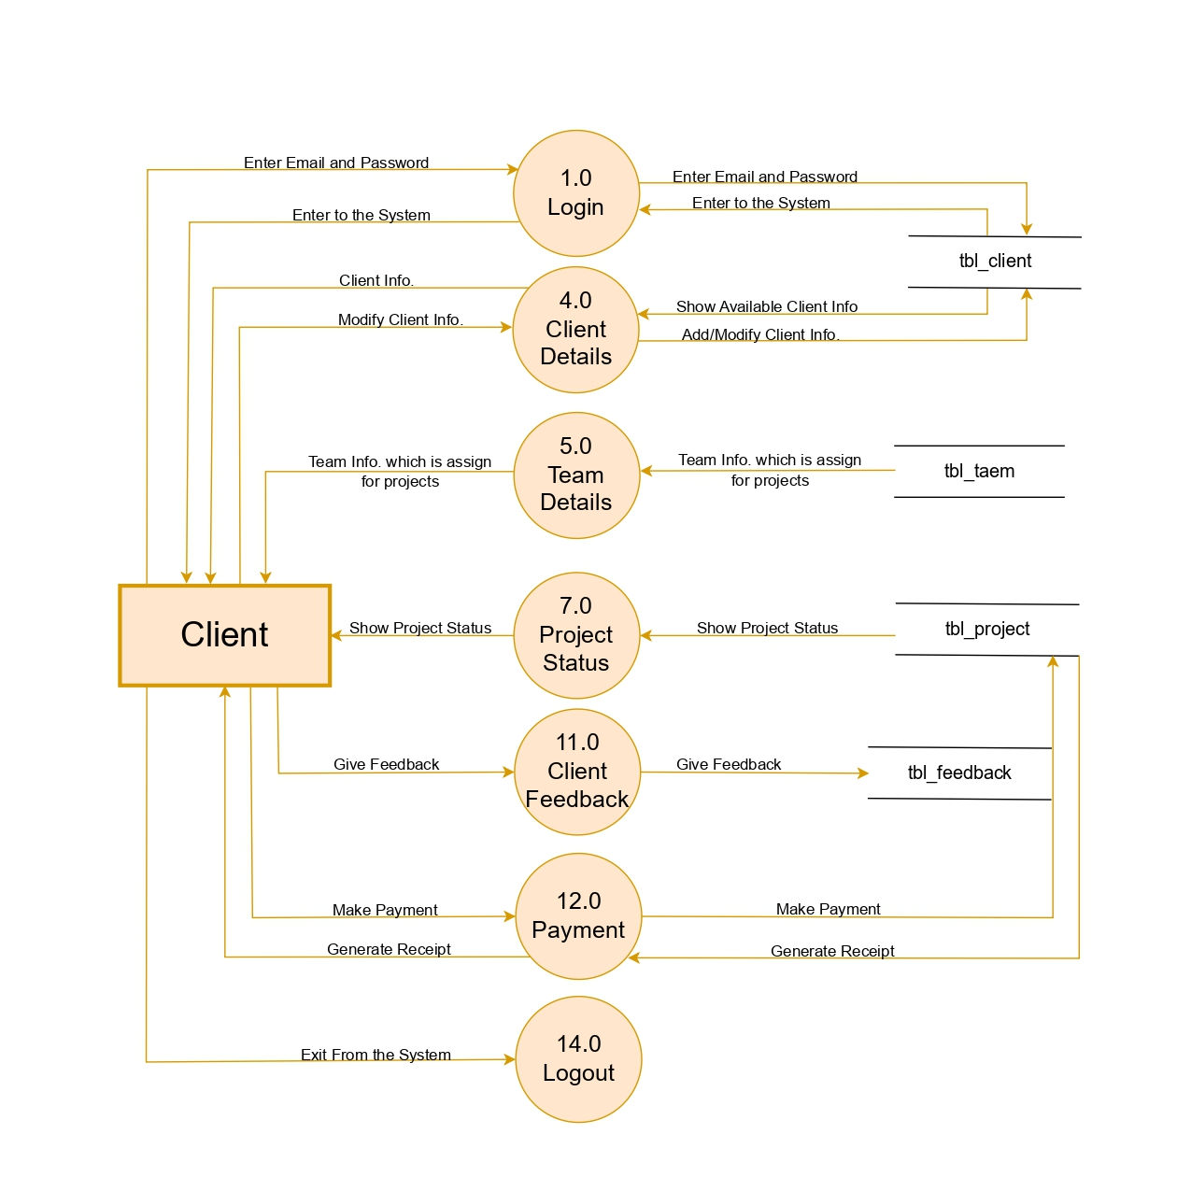
1st Level
Client
Diagram

Slide 23
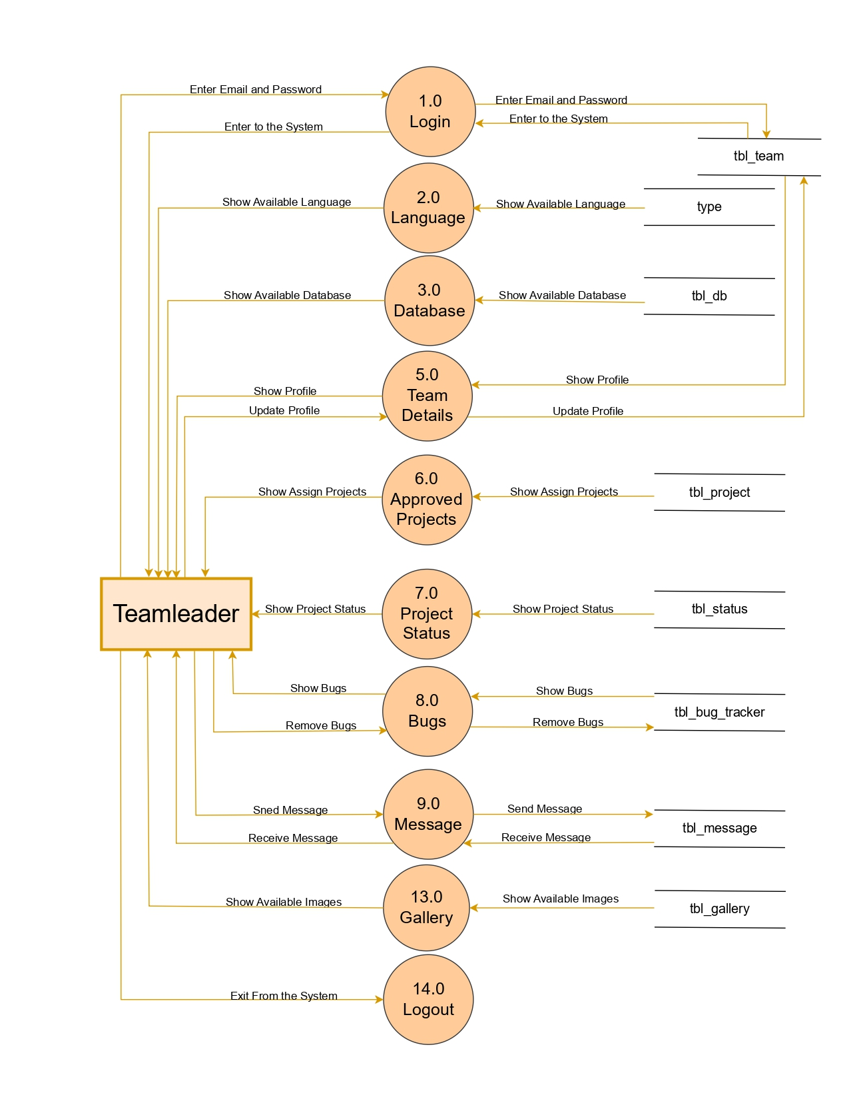
1st Level
Teamleader Diagram

Slide 24
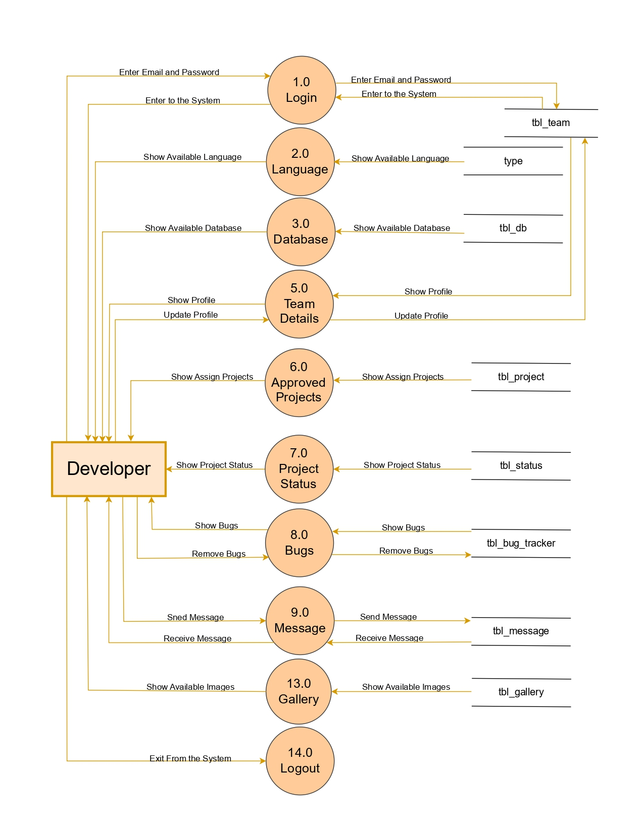
1st Level
DeveloperDiagram

Slide 25
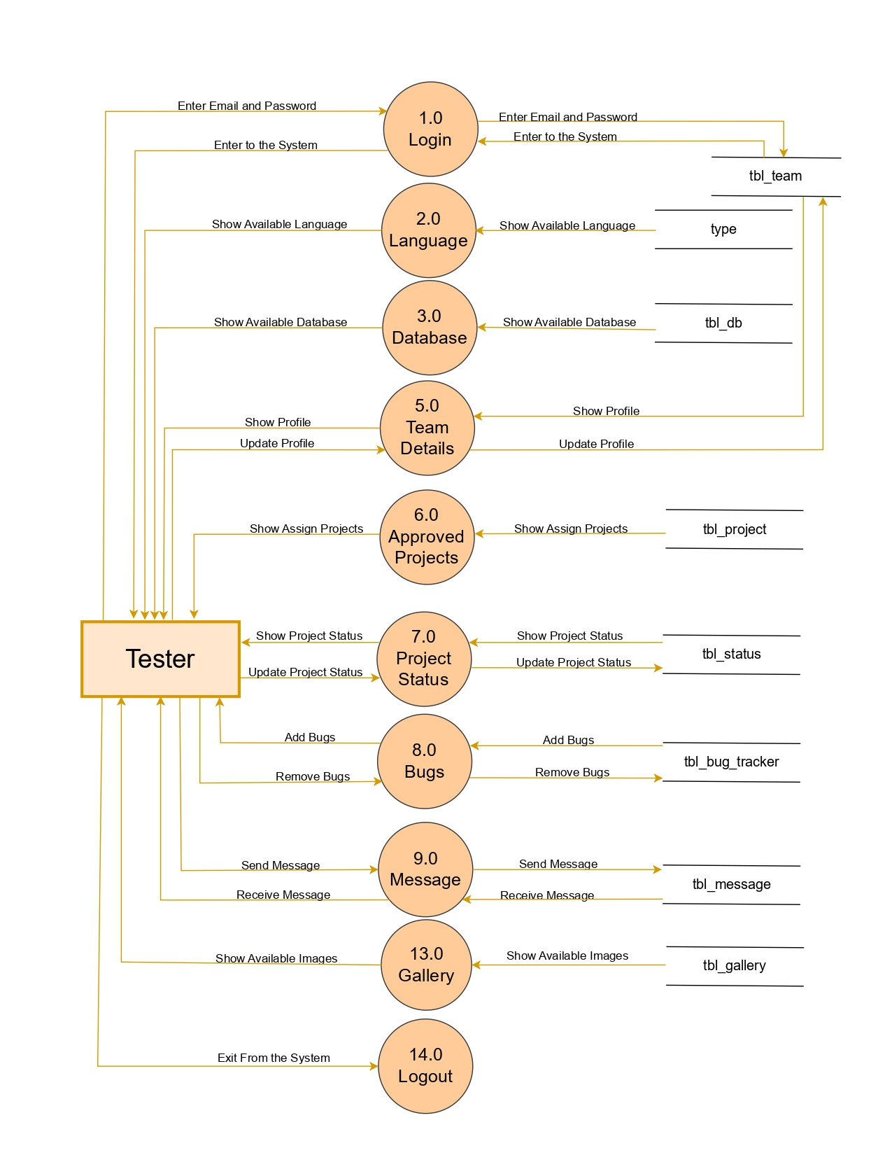
1st Level
Tester Diagram

Slide 26
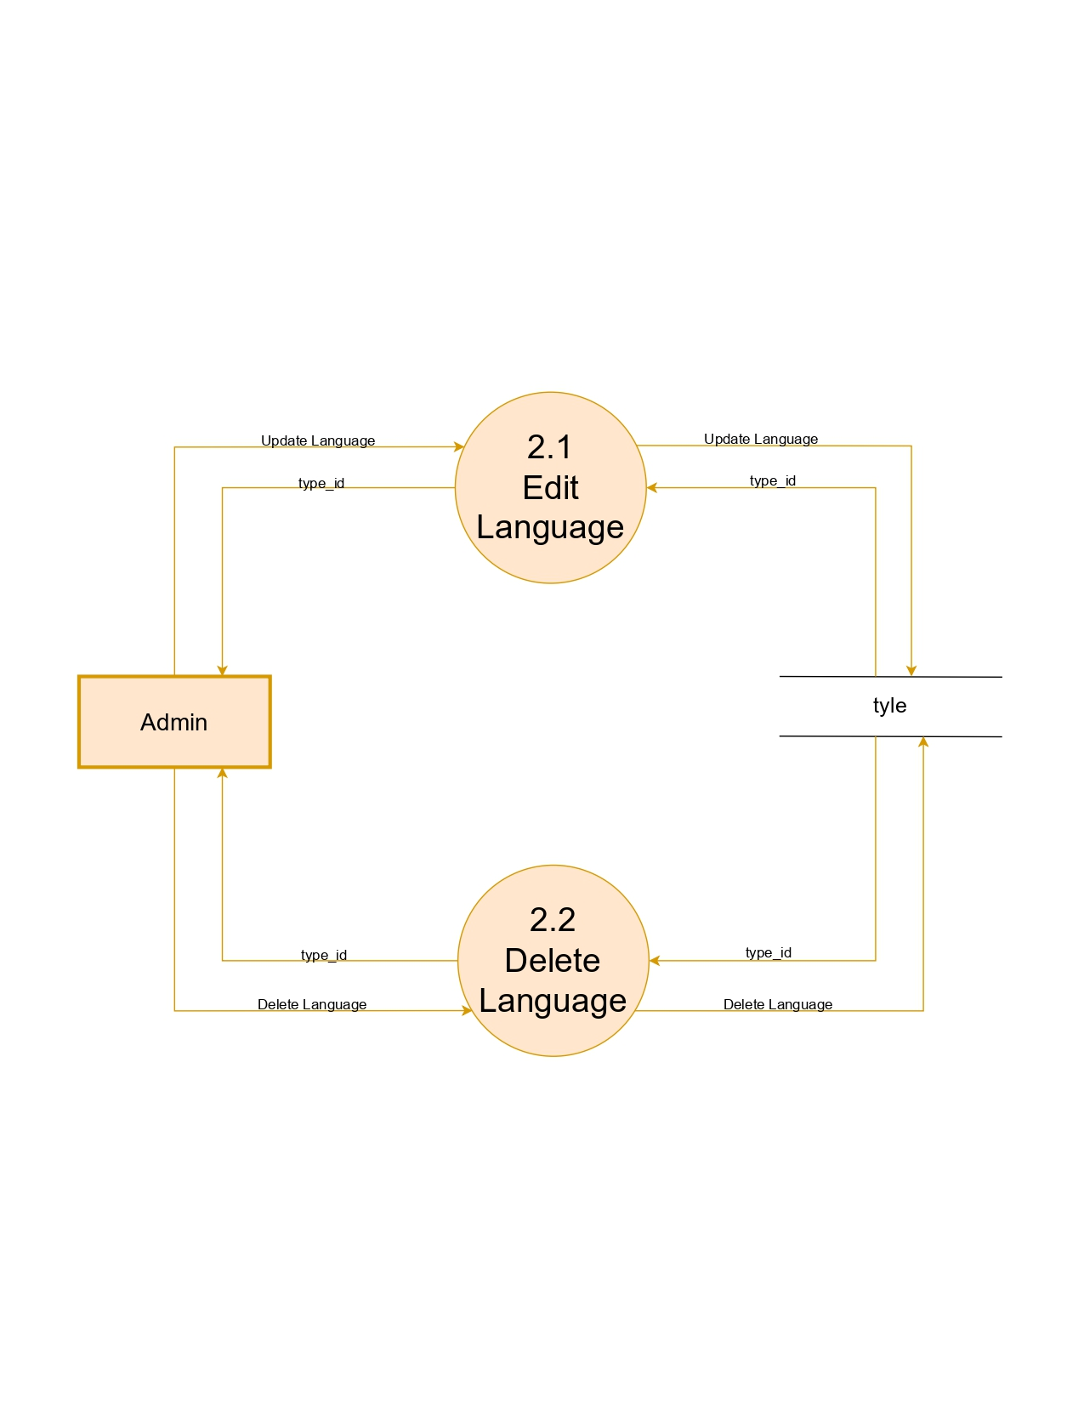
2nd Level
Admin Diagram

Slide 27
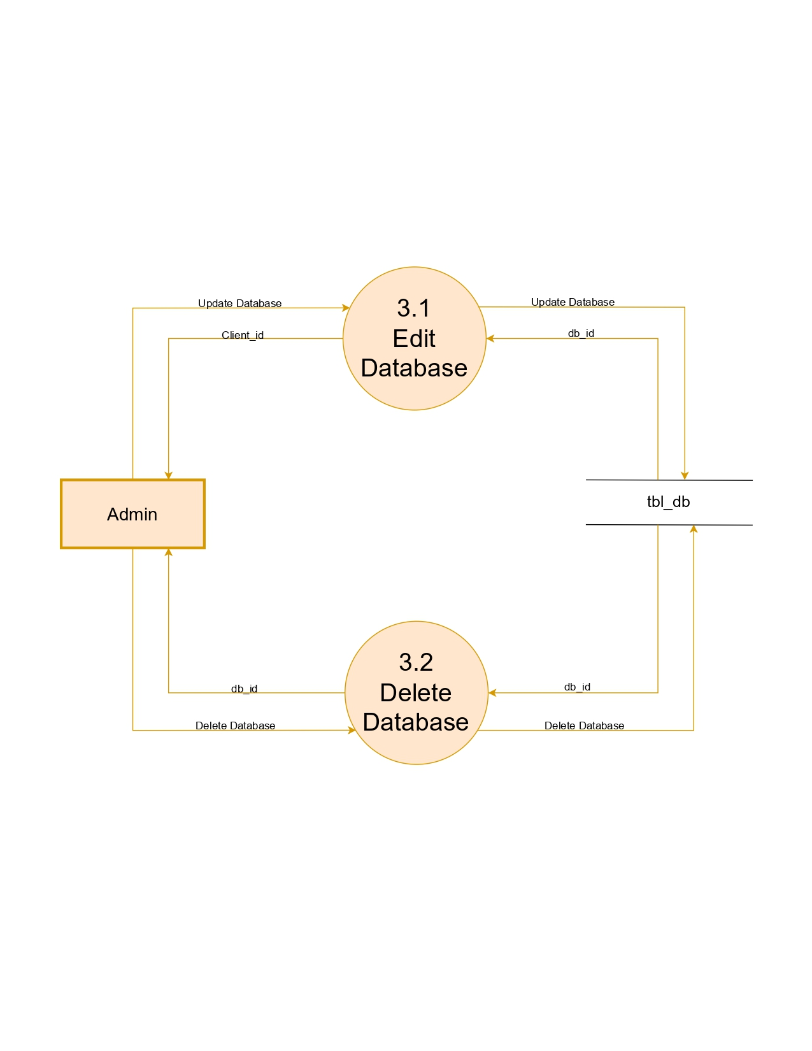
Continue...

Slide 28
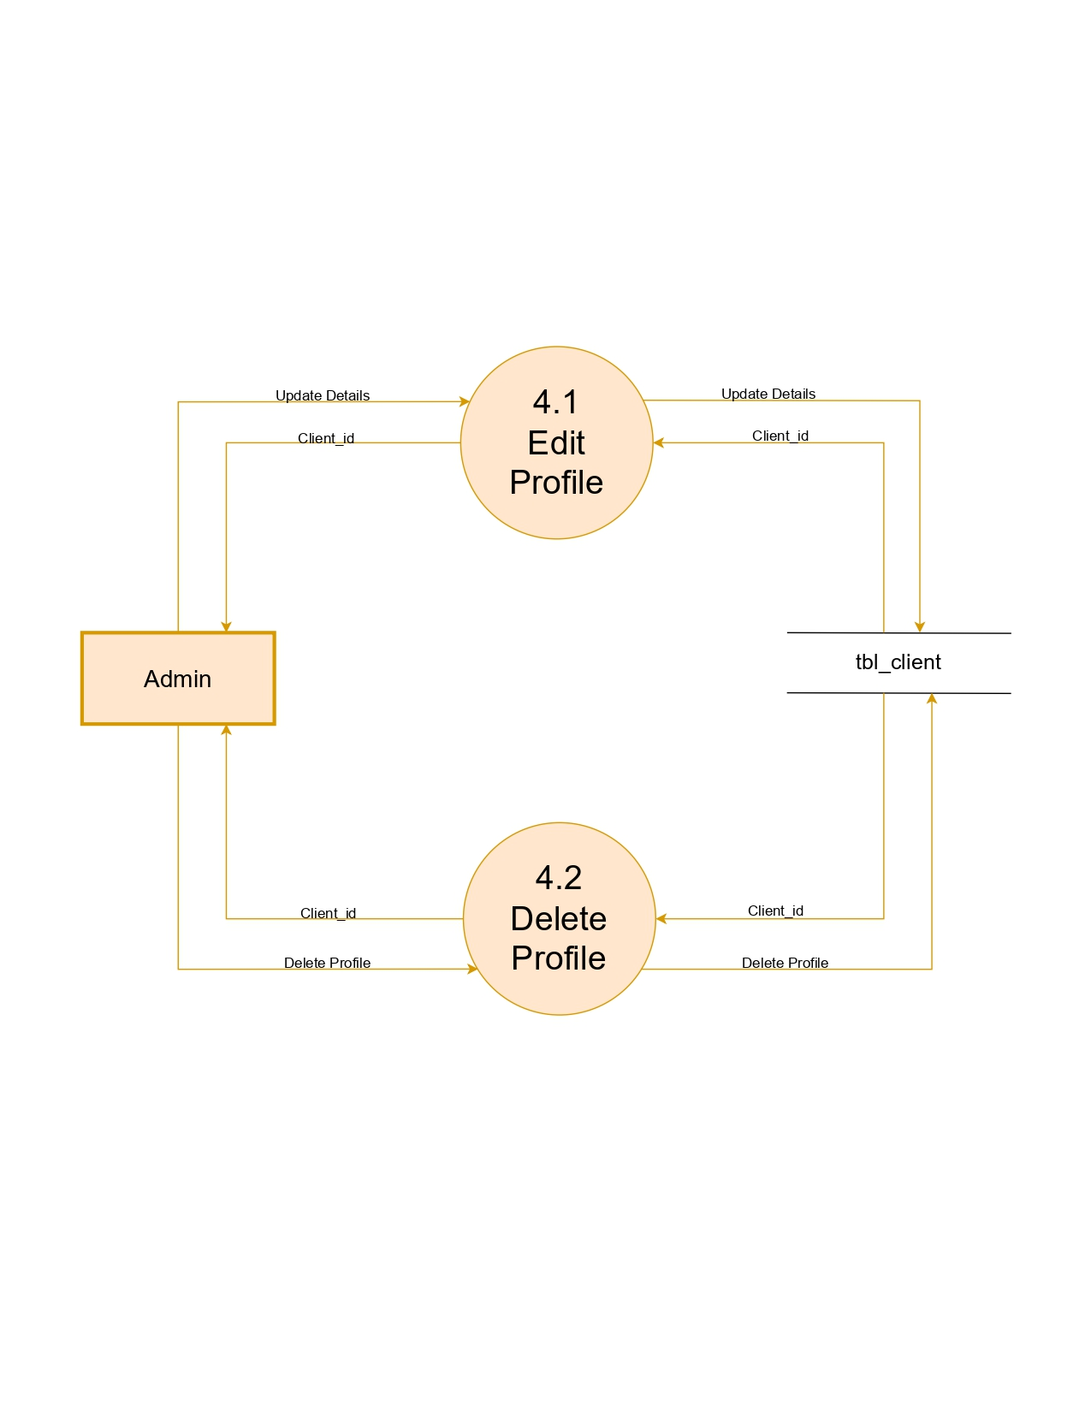
Continue...

Slide 29
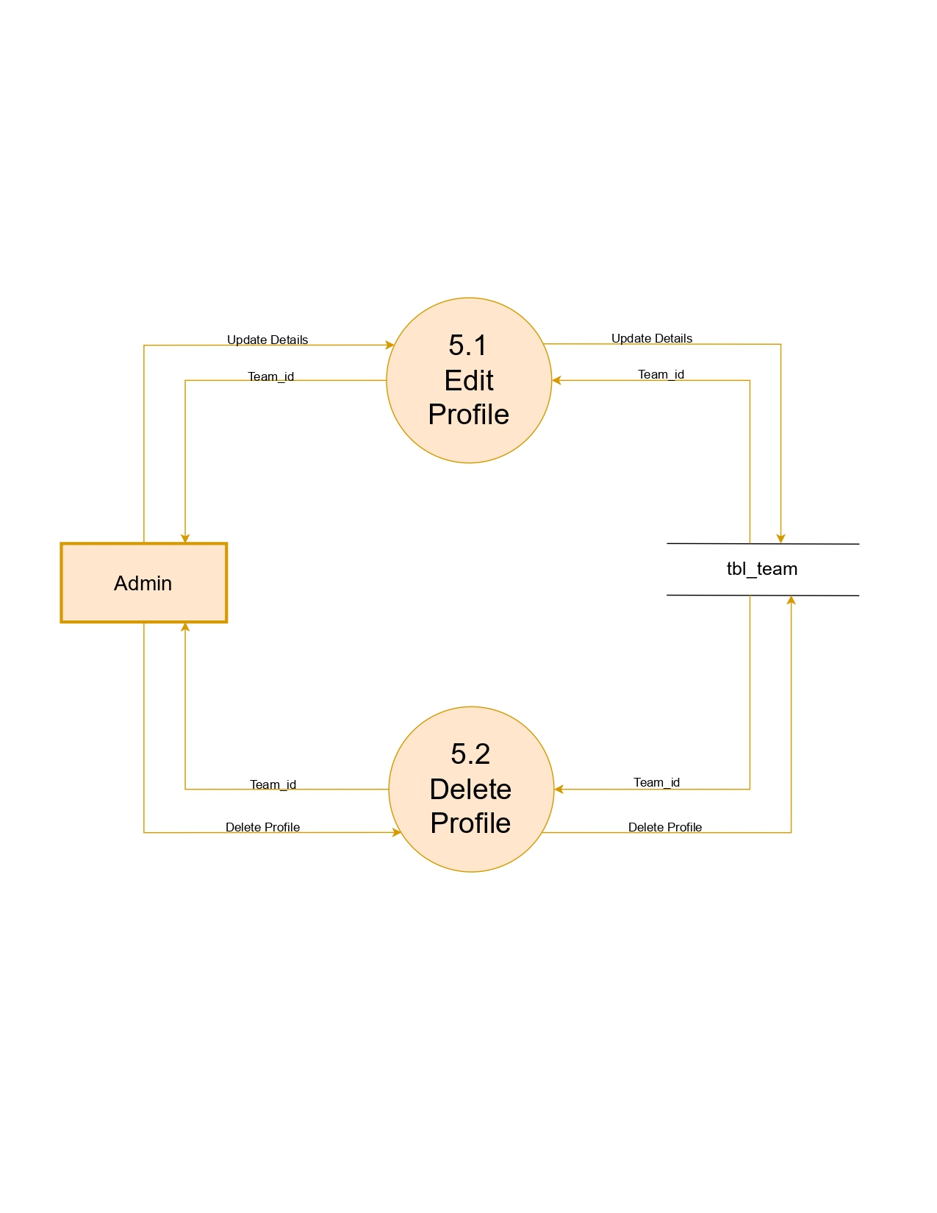
Continue...

Slide 30
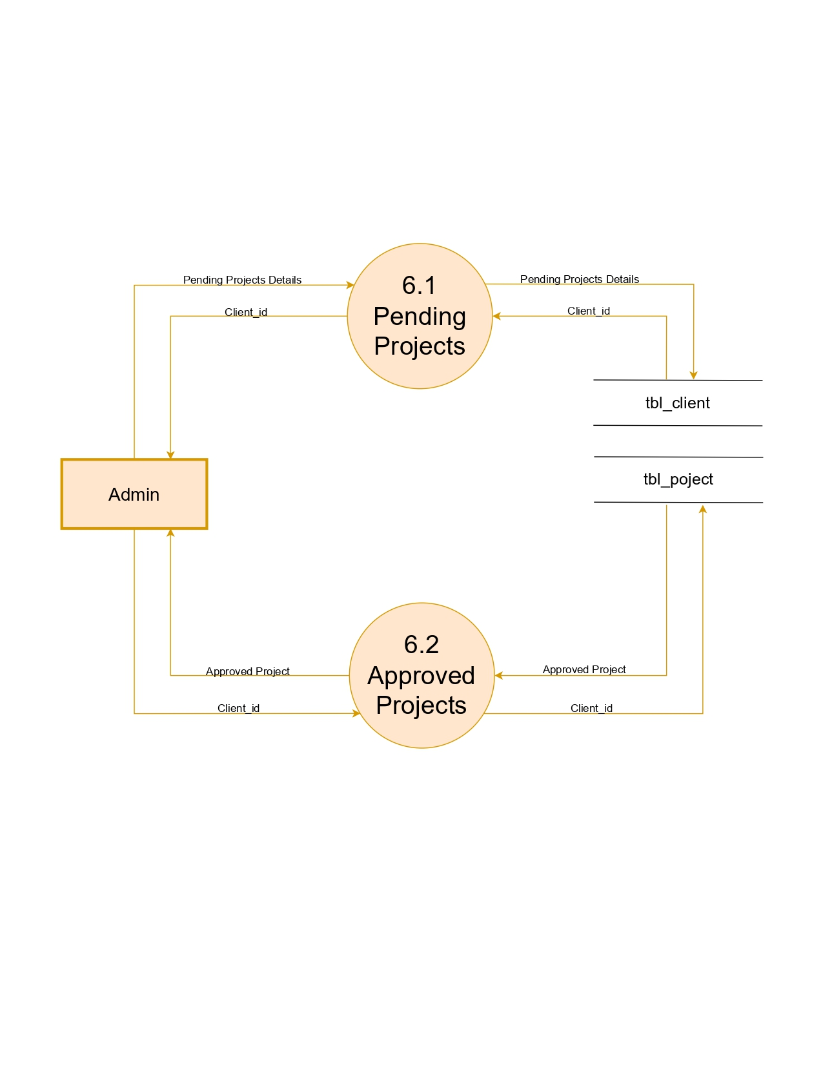
Continue...

Slide 31
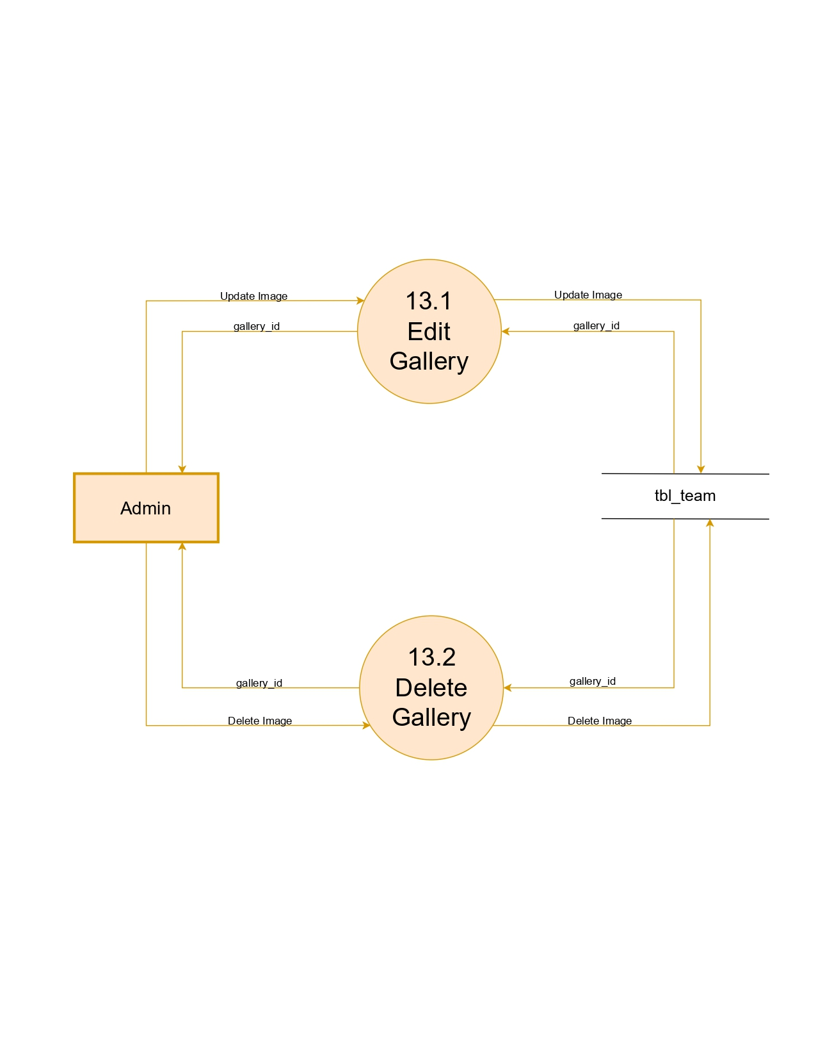
Continue...

Slide 32
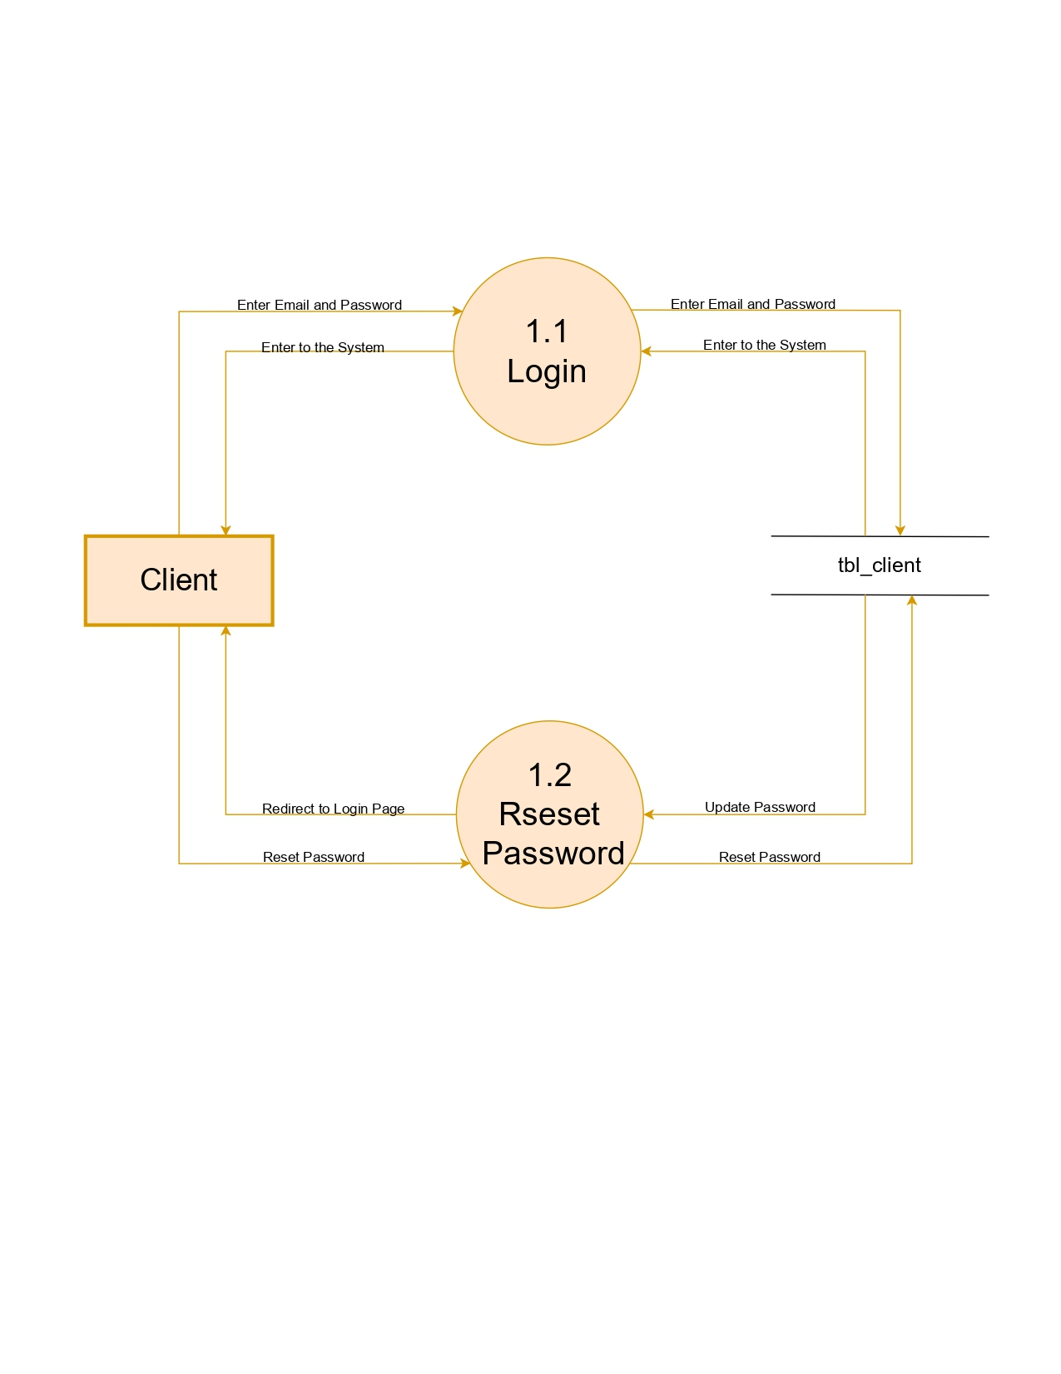
Continue...

Slide 33
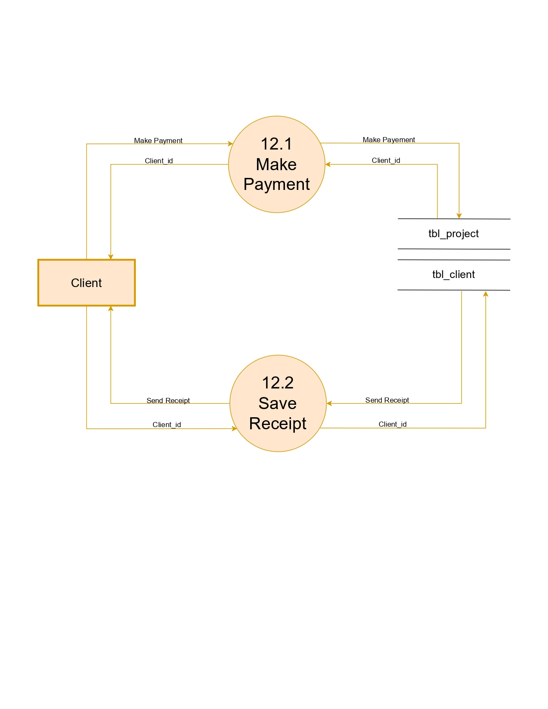
Continue...

Slide 34
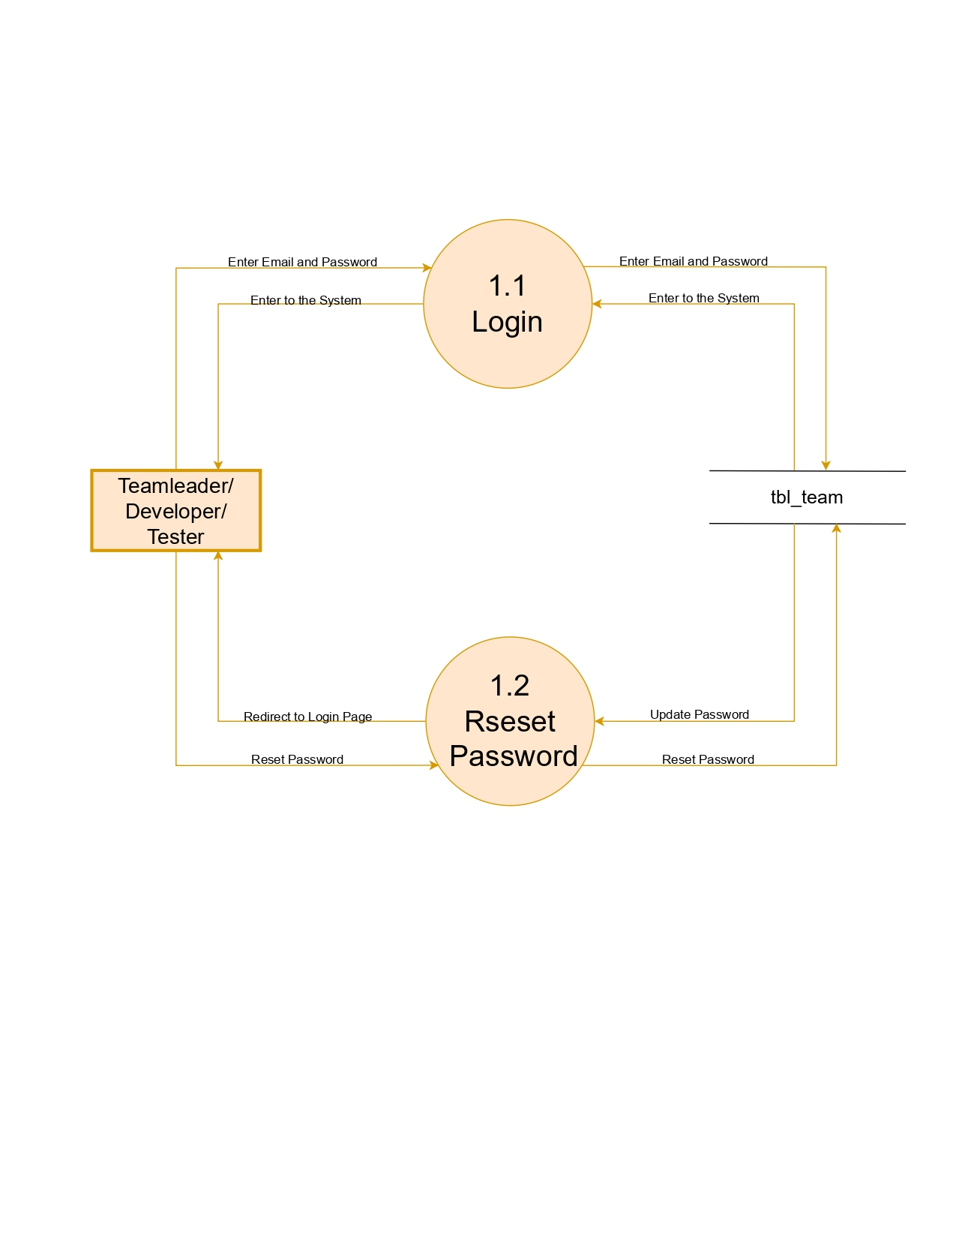
Continue...

Slide 35
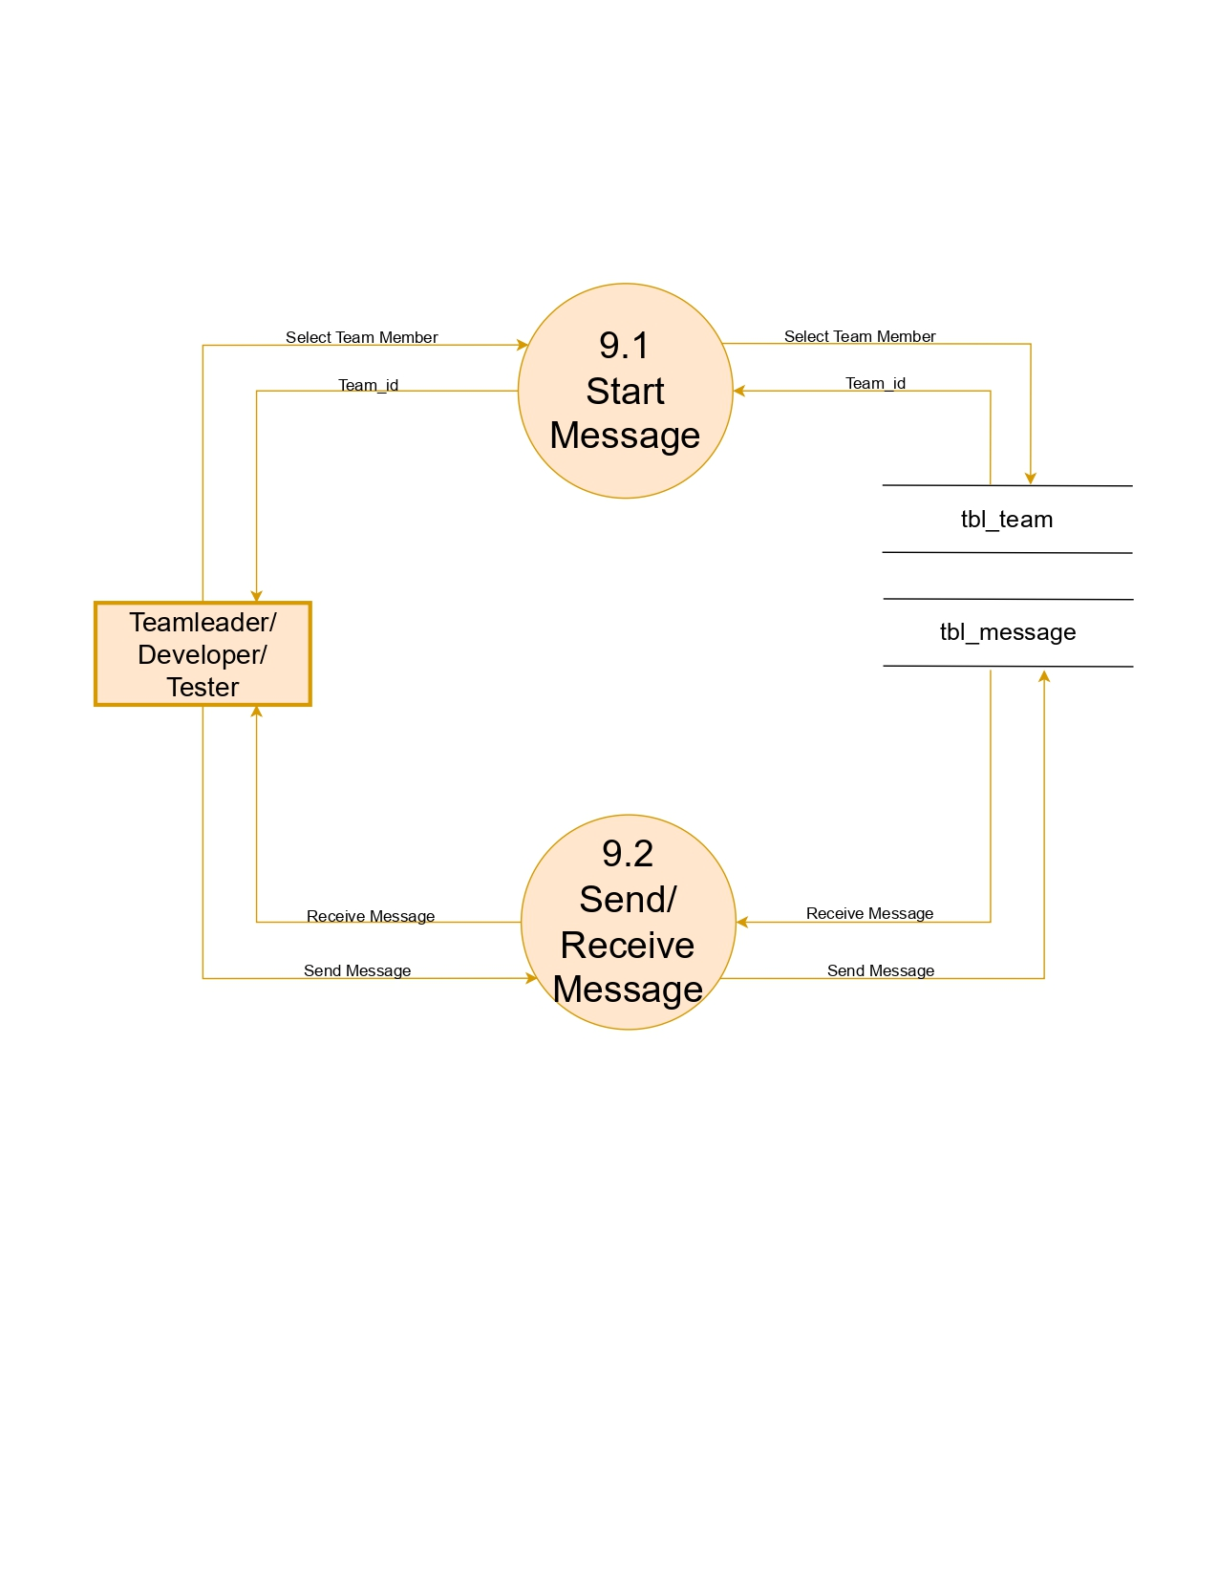
Continue...

Slide 36
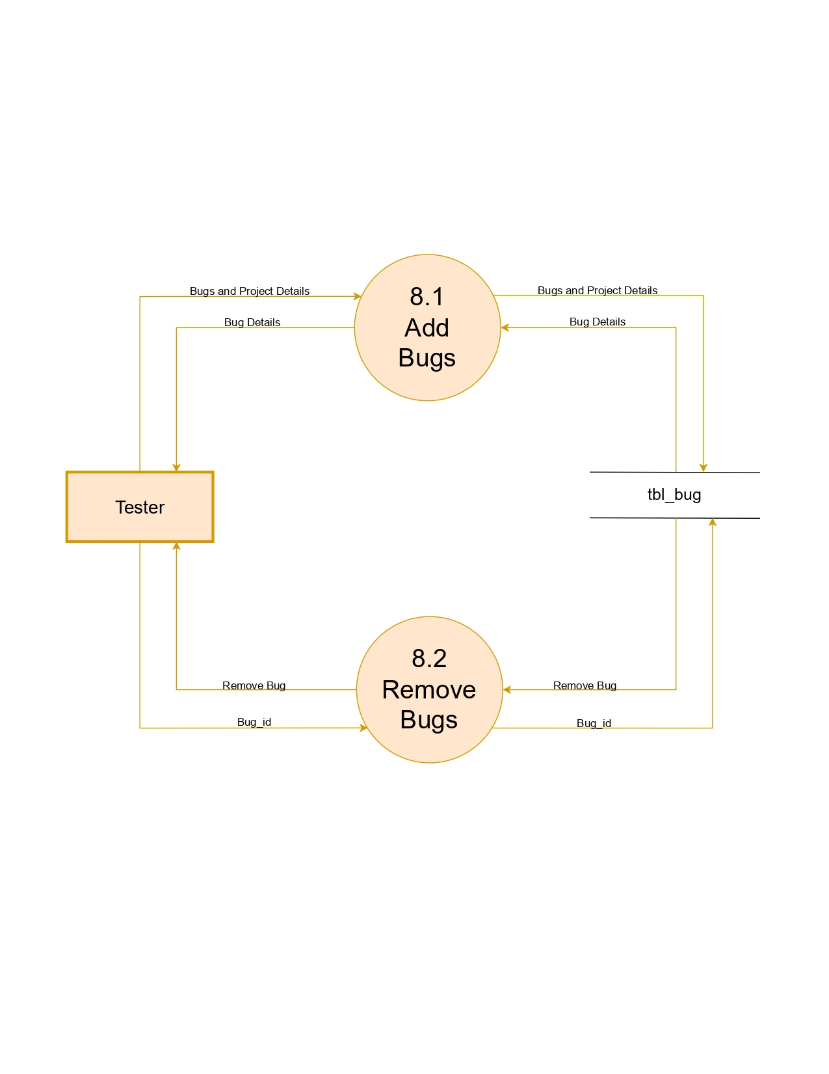

Slide 37
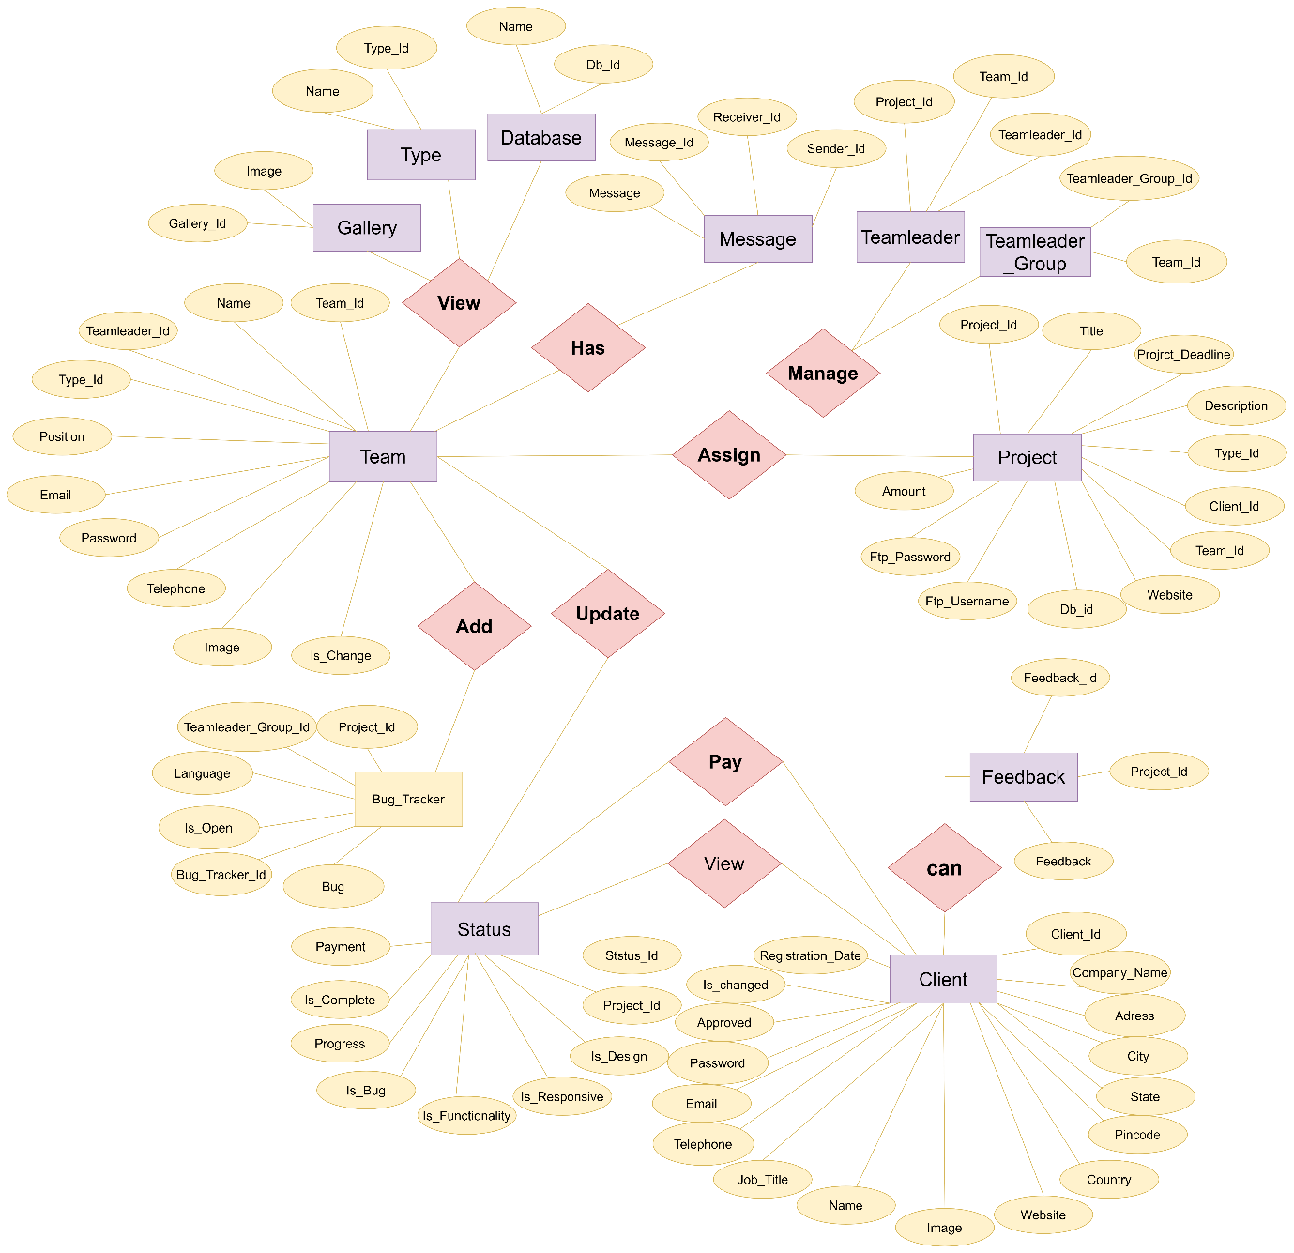
4.2 Entity Relationship Diagram

Slide 38
5. System Design
5.1 Database Design
5.2 Input Design and Output Design

Slide 39
5.1 Database Design
Database Table
Sr.No | Field Name | Data Type | Constraints
1 | Db_id | Int(11) | Primary key
2 | name | Varchar(50)
Massage Table
Sr.No | Field Name | Data Type | Constratints
1 | Message_id | Int(11) | Primary key
2 | Sender_id | Int(11)
3 | Receiver_id | Int(11)
4 | Message | Text
5 | time | Datetime
Gallery Table
Sr.No | Field Name | Data Type | Constratints
1 | Gallery_id | Int(11) | Primary key
2 | image | text
Feedback table
Sr.No | Field Name | Data Type | Constratints
1 | Feedback_id | Int(11) | Primary key
2 | Project_id | Int(11) | Foreign key
3 | Feedback | Text
4 | date | datetime
Type Table
Sr.No | Field Name | Data Type | Constratints
1 | Type_id | Int(11) | Primary key
2 | name | Varchar(50)

Slide 40
5.1 Database Design
project table
Sr.No | Field Name | Data Type | Constratints
1 | Project_id | Int(11) | Primary key
2 | Title | Varchar(50)
3 | Project_deadline | Date
4 | Description | Varchar(100)
5 | Type_id | Varchar(100) | Foreign key
6 | Client_id | Int(11) | Foreign key
7 | Team_id | Int(11) | Foreign key
8 | Website | Varchar(50)
9 | Db_id | Varchar(50) | Foreign key
10 | ftp_username | Varchar(50)
11 | ftp_password | Varchar(50)
12 | amount | Int(11)
Status Table
Sr.No | Field Name | Data Type | Constraints
1 | Status_id | Int(11) | Primary key
2 | Project_id | Int(11) | Foreign key
3 | Is_design | Tinyint(1)
4 | Is_responsive | Tinyint(1)
5 | Is_functionality | Tinyint(1)
6 | Is_bug | Tinyint(1)
7 | Progree | Int(3)
8 | Is-complete | Tinyint(1)
9 | payment | Tinyint(1)

Slide 41
5.1 Database Design
Client Table
Sr.No | Field Name | Data Type | Constraints
1 | Client_id | Int(11) | Primary key
2 | Company_name | Varchar(100)
3 | Address | Text
4 | City | Varchar(50)
5 | State | Varchar(50)
6 | Pincode | Int(6)
7 | Country | Varchar(50)
8 | Website | Varchar(50)
9 | Profile_pic | Varchar(50)
10 | Name | Varchar(50)
11 | Job_title | Varchar(50)
12 | Telephone | Varchar(50)
13 | Email | Varchar(50)
14 | Password | Varchar(50)
15 | Approved | Tinyint(1)
16 | Is_changed | Tinyint(1)
17 | Registration_date | date
Team Table
Sr.No | Field Name | Data Type | Constratints
1 | Team_id | Int(11) | Primary key
2 | Teamleader_id | Int(11) | Foreign key
3 | Name | Varchar(50)
4 | Type_id | Varchar(50) | Foreign key
5 | Position | Tinyint(1)
6 | Email | Varchar(50)
7 | Password | Varchar(50)
8 | Telephone | Varchar(50)
9 | Profile_pic | Varchar(50)
10 | Is_changed | Tinyint(1)

Slide 42
5.1 Database Design
TeamLeader Table
Sr.No | Field Name | Data Type | Constratints
1 | Teamleader_id | Int(11) | Primary key
2 | Team_id | Int(11) | Foreign key
3 | name | Varchar(50)
Bug Tracker Table
Sr.No | Field Name | Data Type | Constraints
1 | Bug_tracker_id | Int(11) | Primary key
2 | Project_id | Int(11) | Foreign key
3 | Teamleader_group_id | Int(11) | Foreign key
4 | Bug | Text
5 | Is_open | Tinyint(1)
6 | Language | Int(11)
7 | Created_date | timestamp
TeamLeader Group Table
Sr.No | Field Name | Data Type | Constratints
1 | Teamleader_group_id | Int(11) | Primary key
2 | Team_id | Int(11) | Foreign key
3 | Project_id | Int(11) | Foreign key
4 | Allocate_date | datetime

Slide 43
5.2
Input Design and Output Design

Slide 44
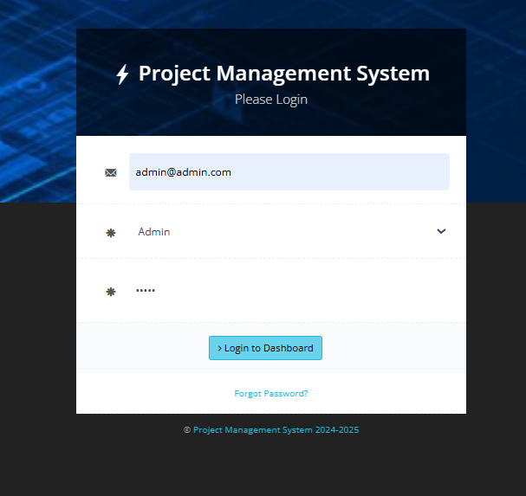
Admin Design
Login Page

Slide 45
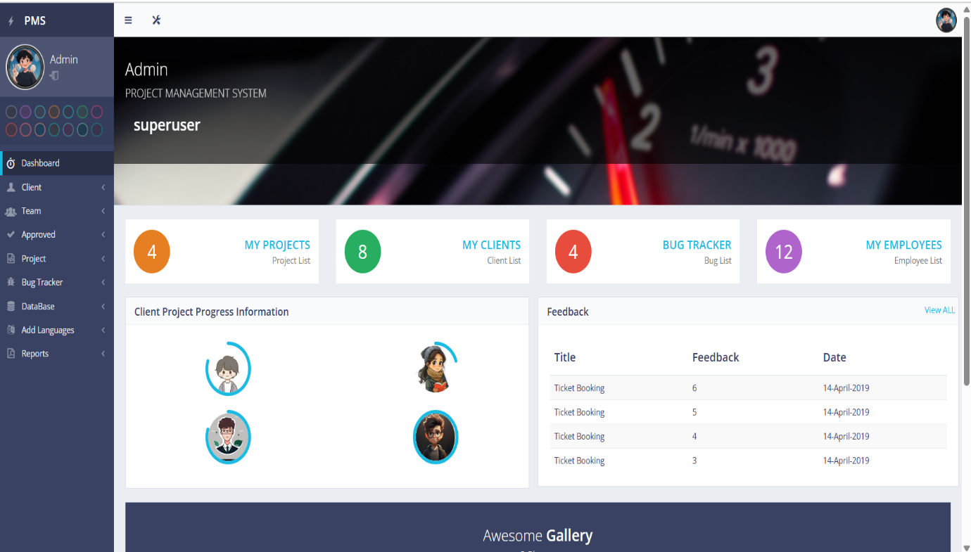
Dashboard Page

Slide 46
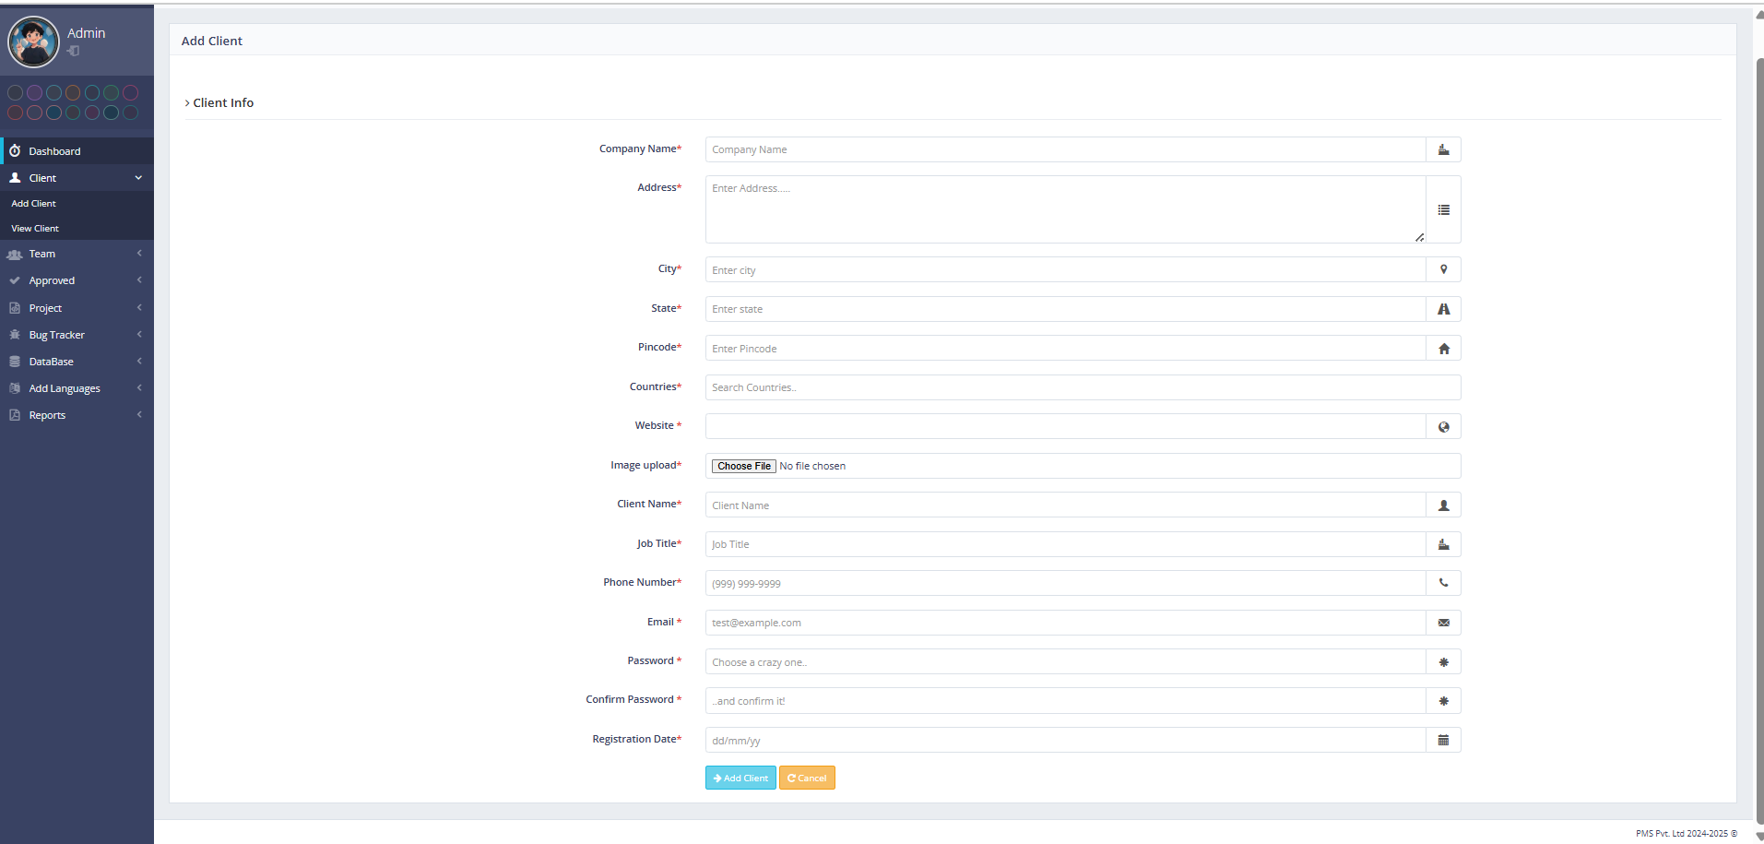
Add Client page

Slide 47
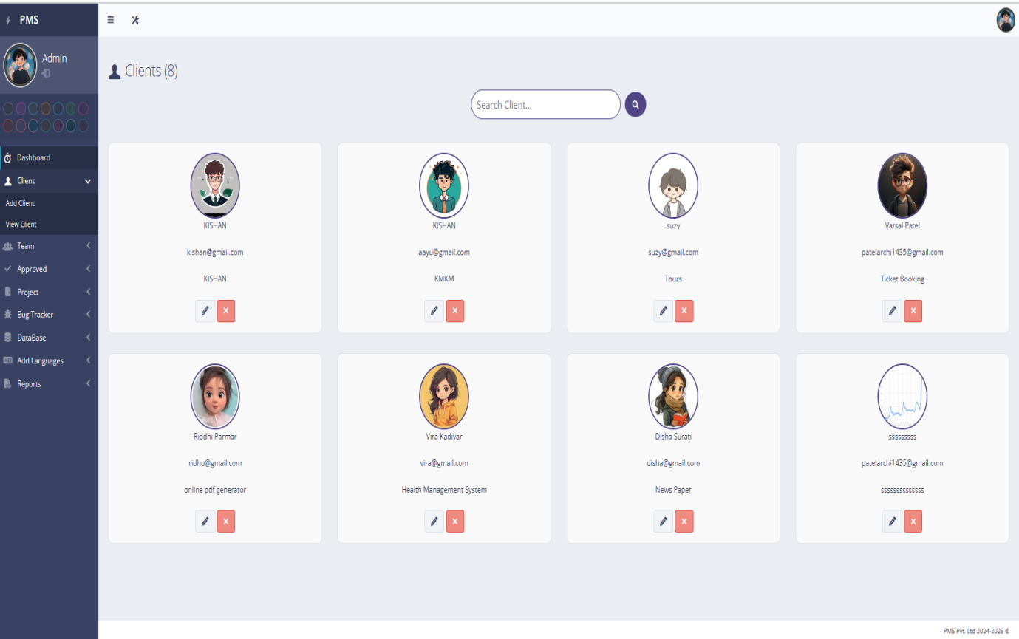
View Client page

Slide 48
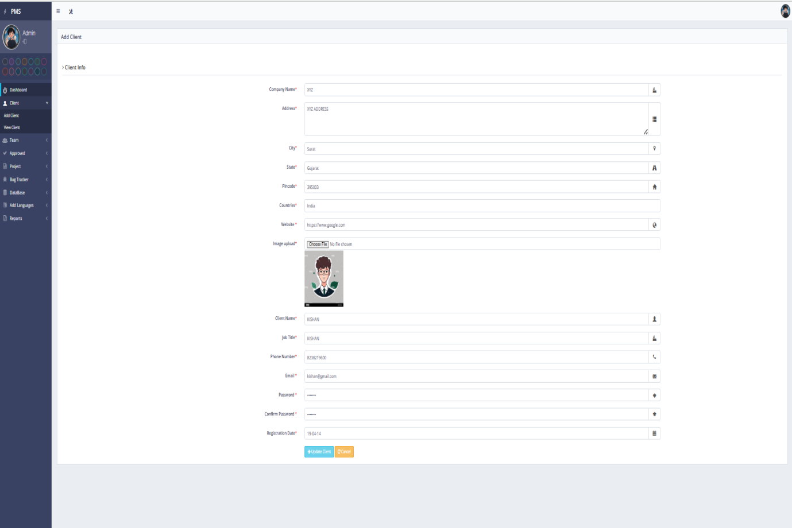
View and Update Client Data page

Slide 49
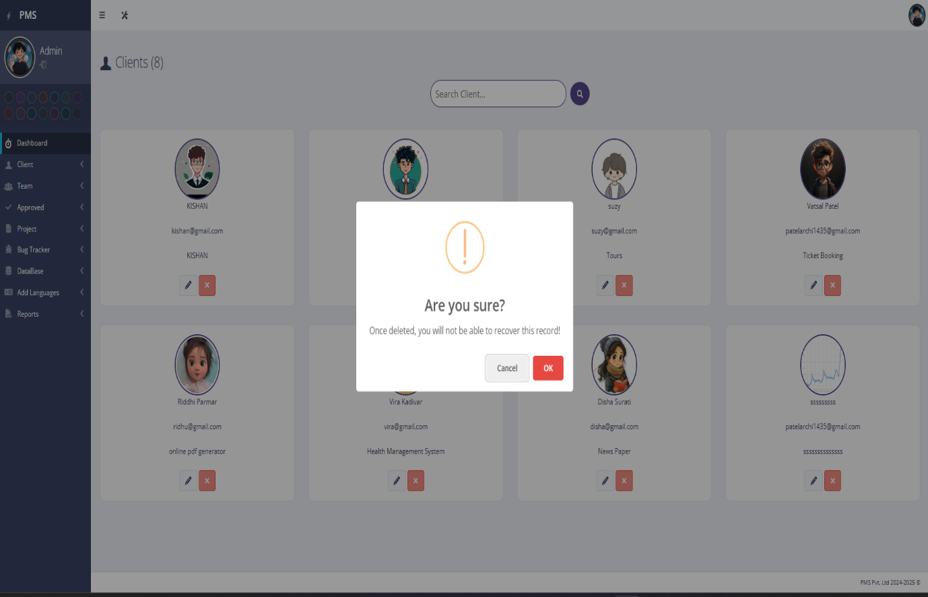
Delete Client

Slide 50
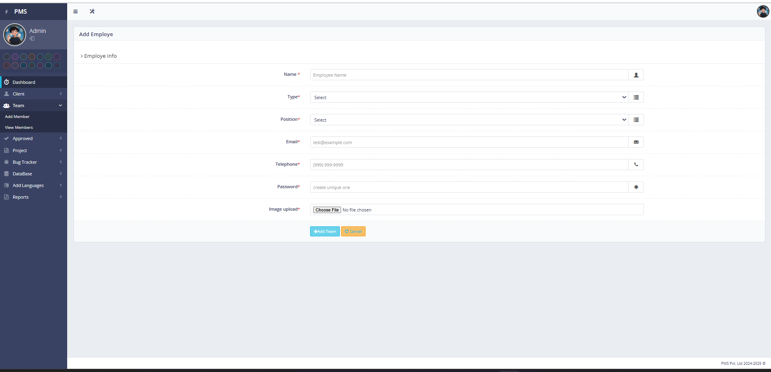
Add Team Member :

Slide 51
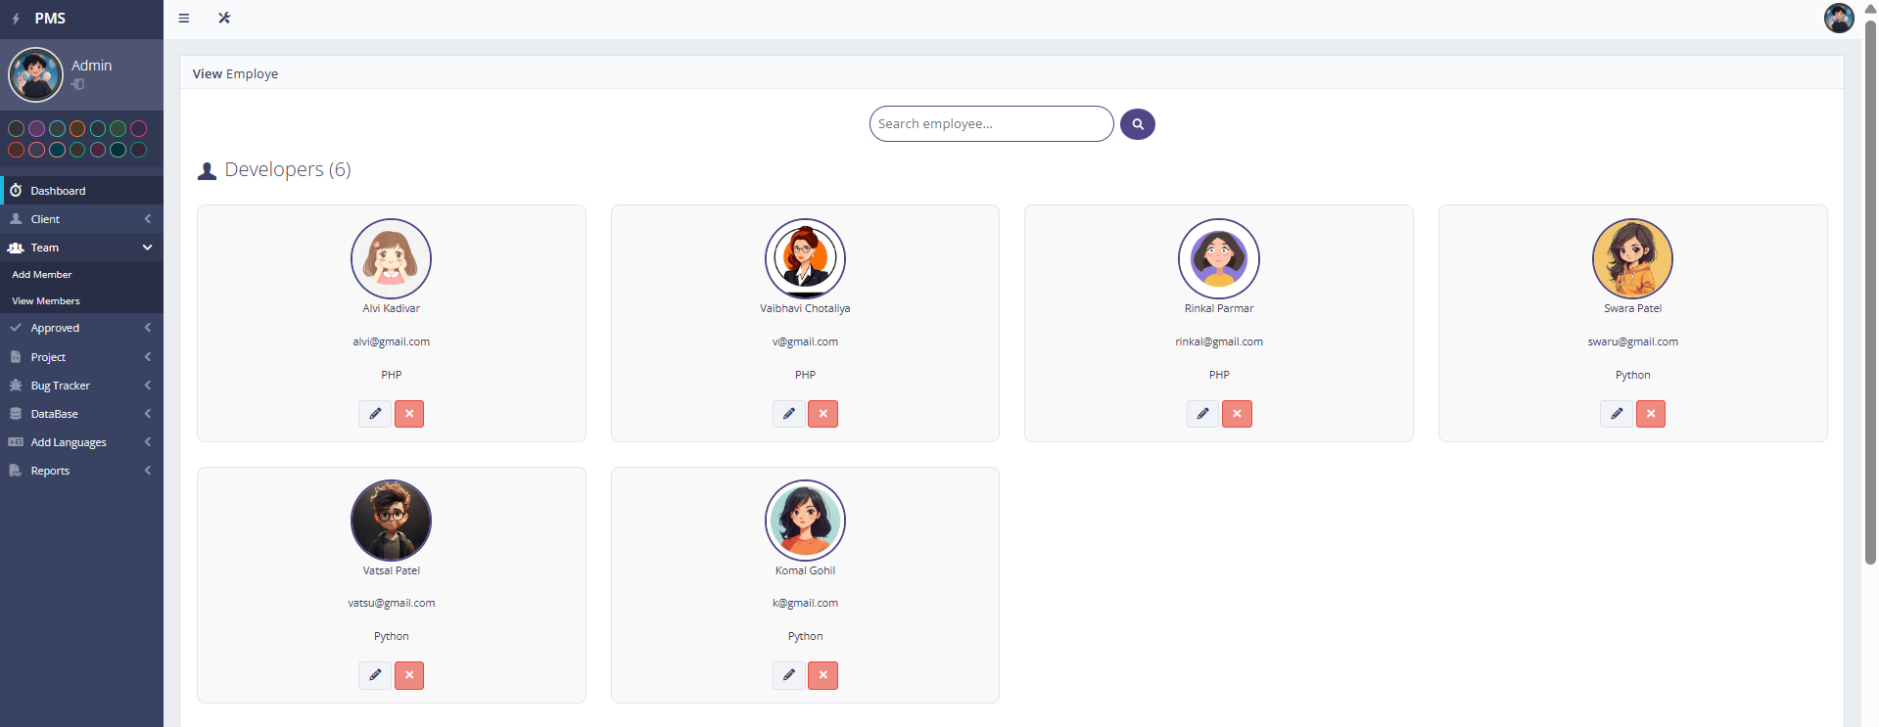
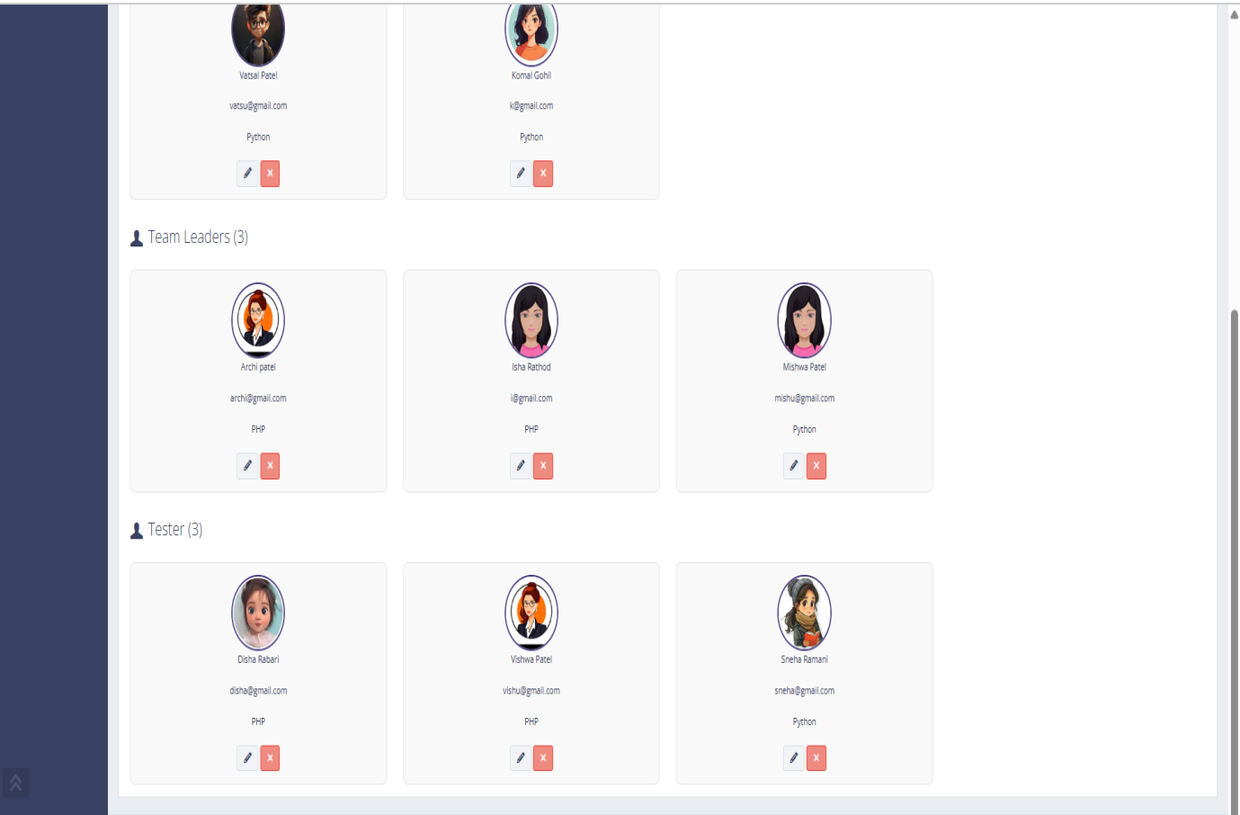
view All members

Slide 52
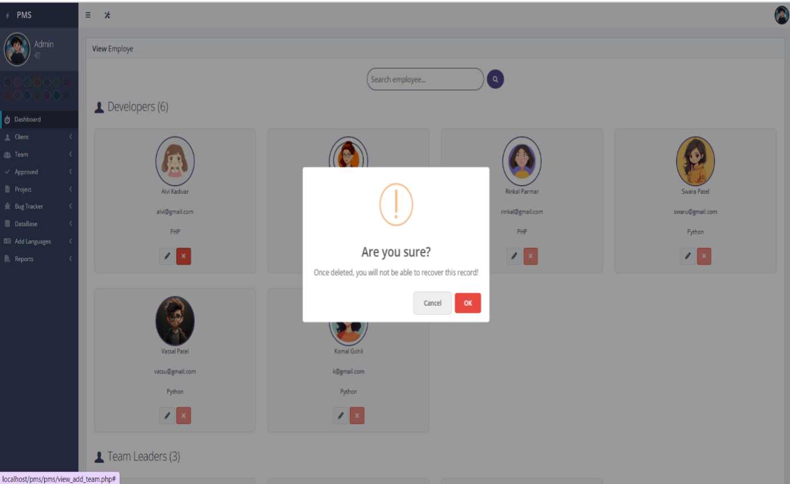
Delete

Slide 53
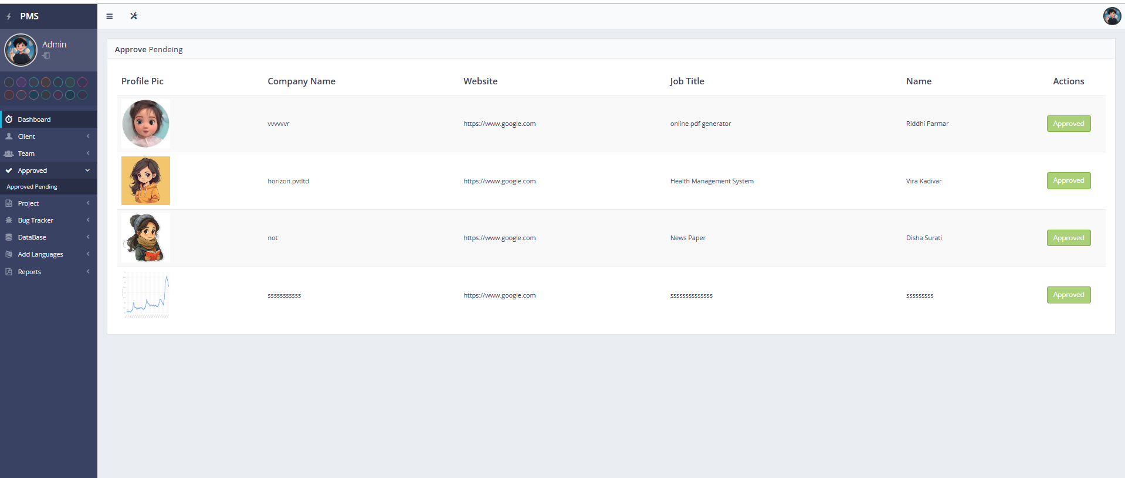
View Approved clients

Slide 54
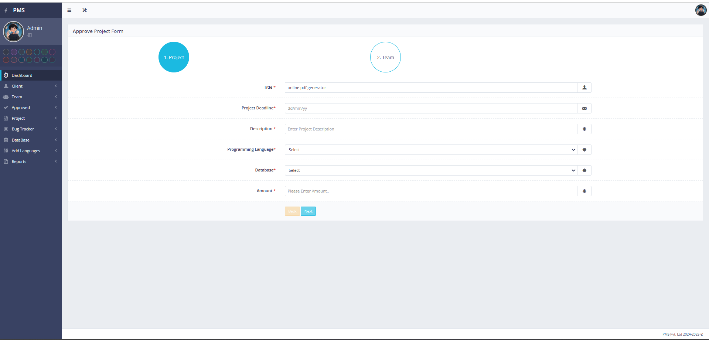
Approve client

Slide 55
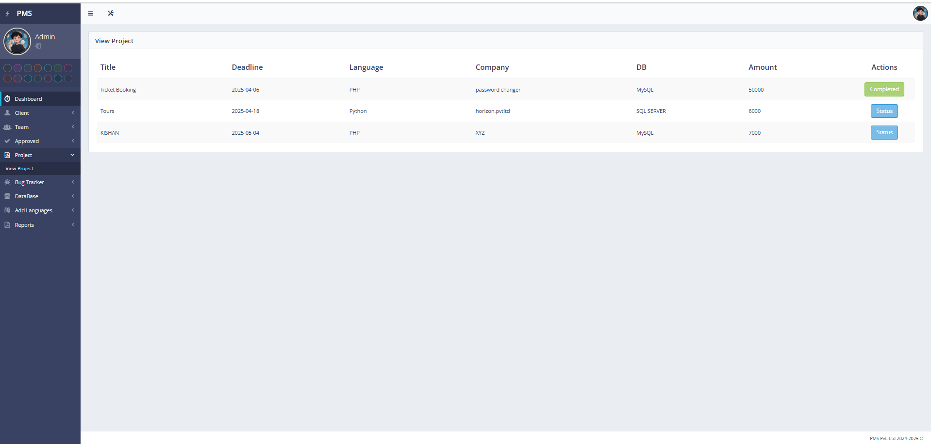
View Projects

Slide 56
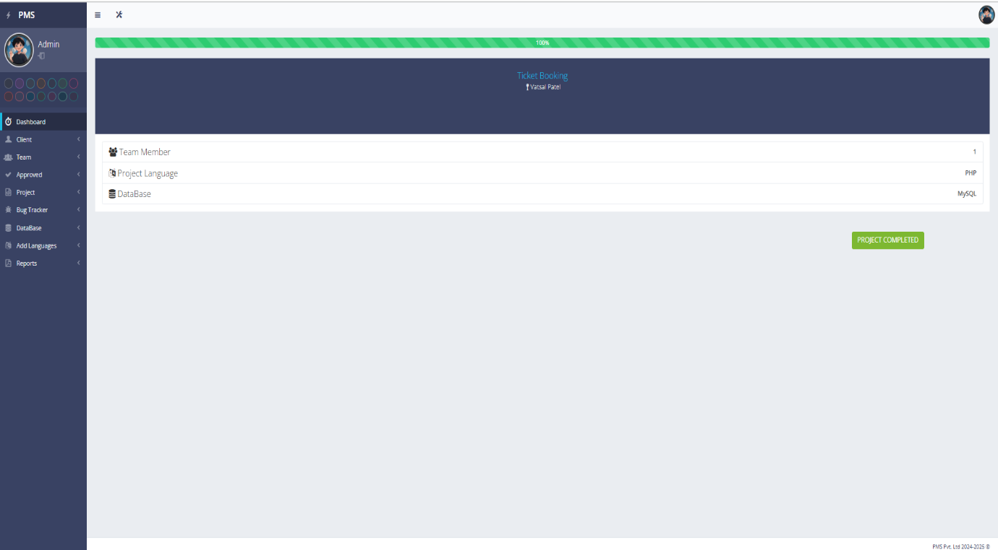
Check status

Slide 57
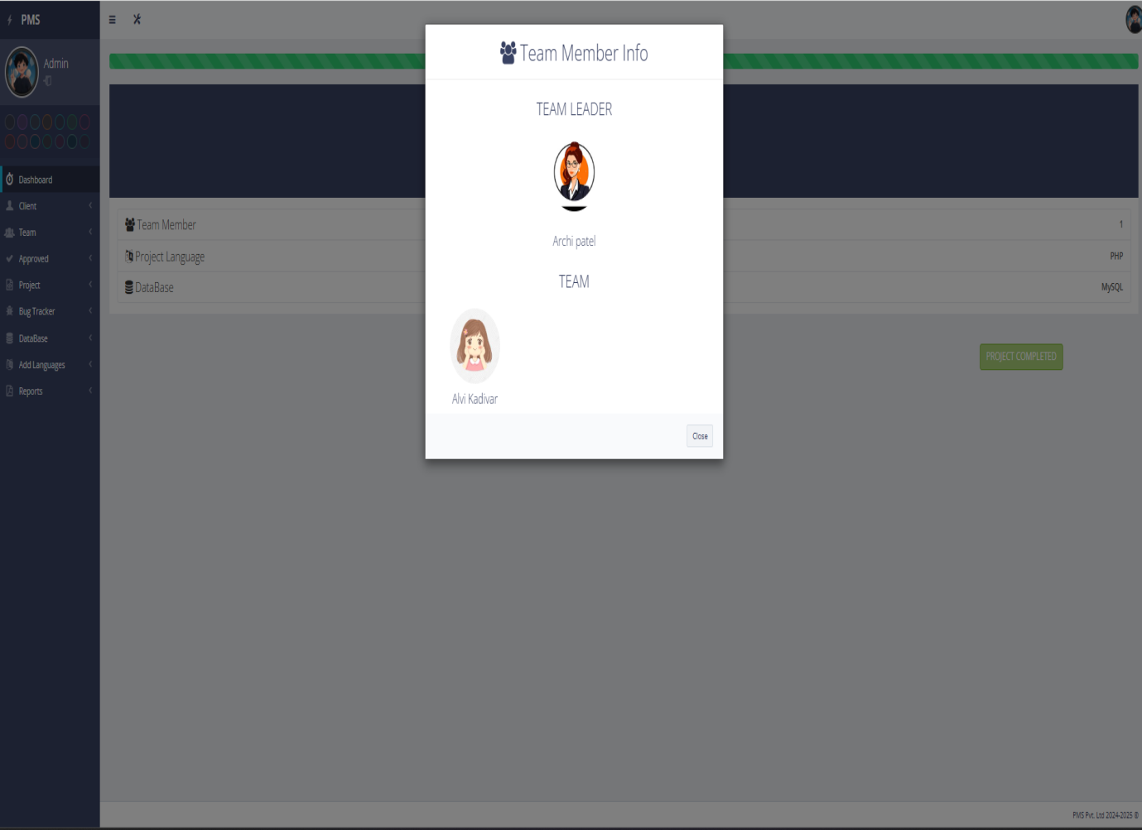
View team members

Slide 58
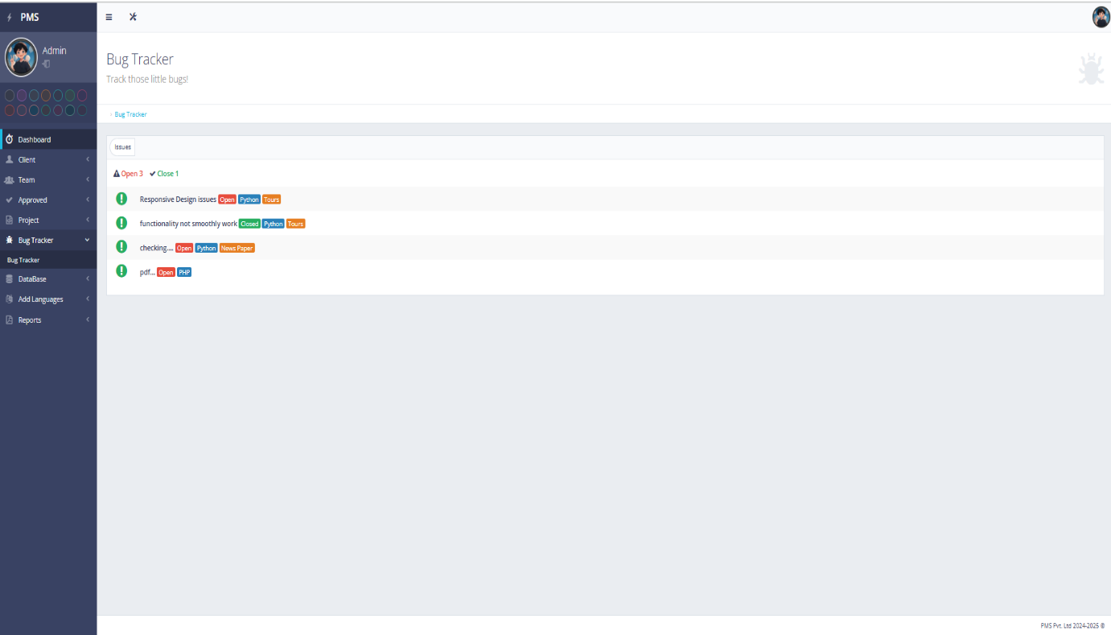
Bug tracker

Slide 59
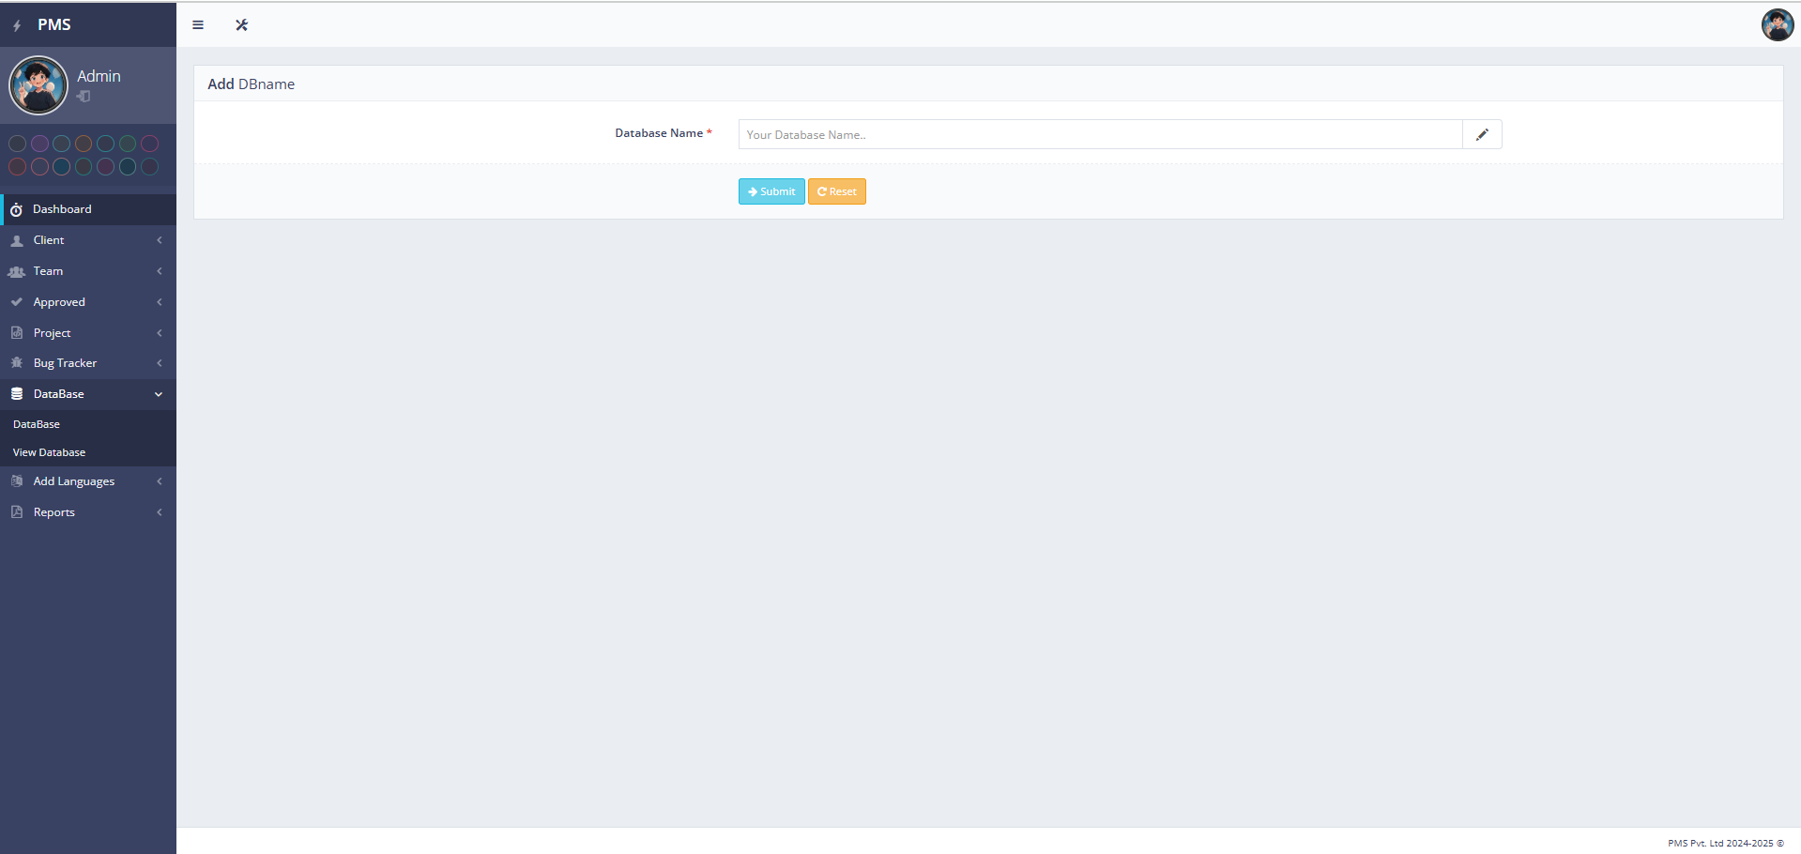
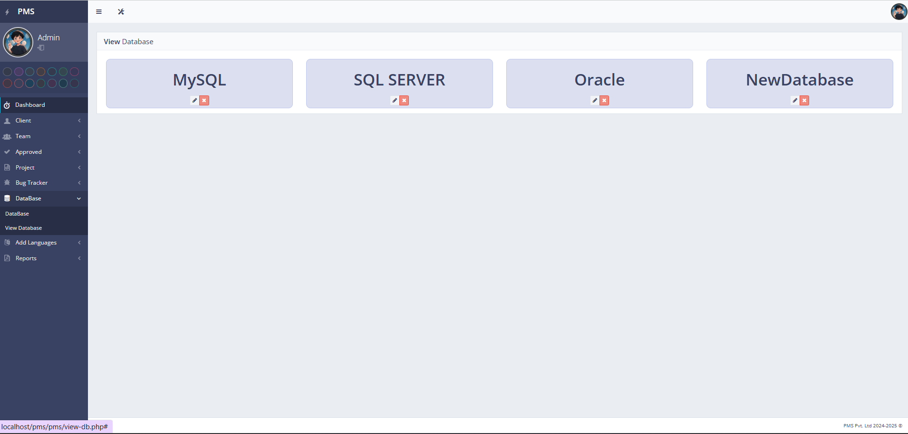
Add/Modify Database

Slide 60
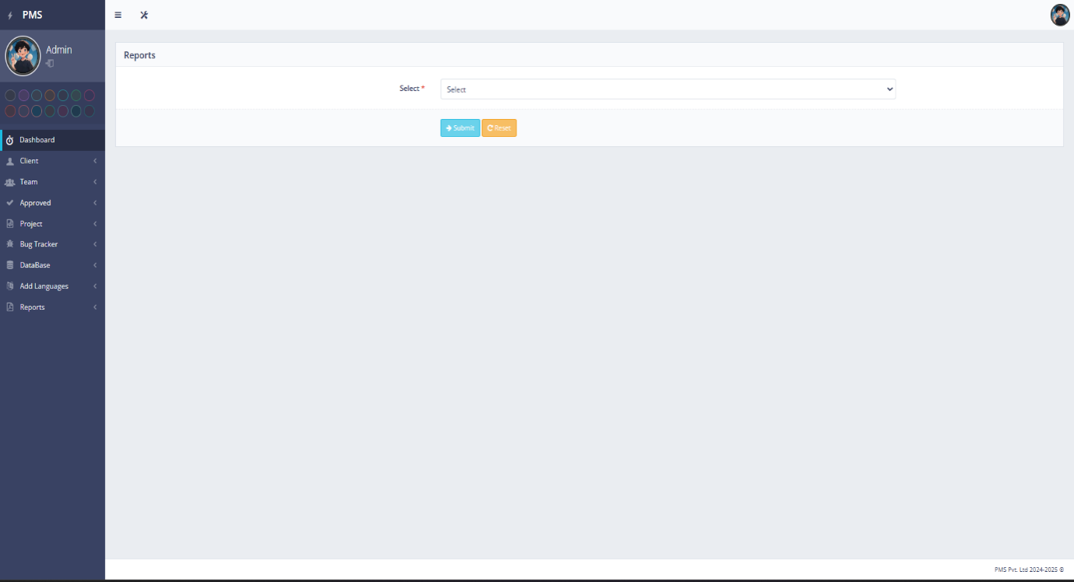
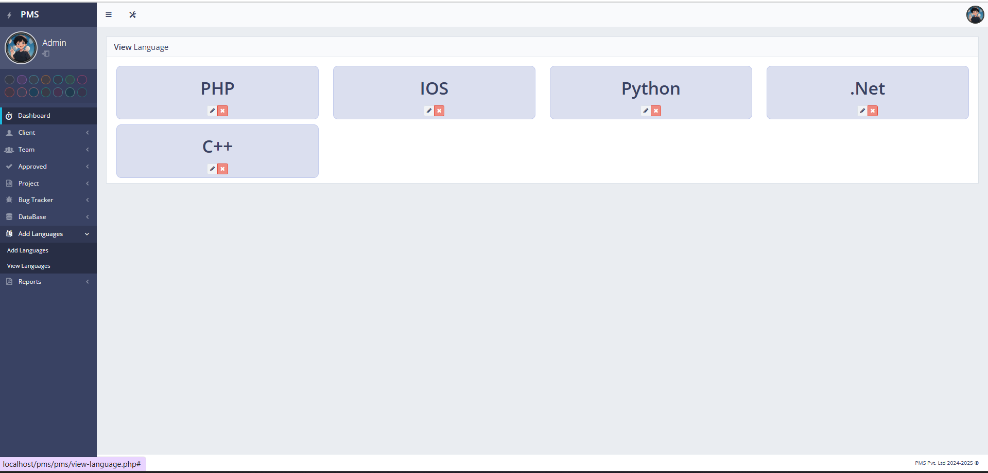
Add/Modify Language

Slide 61
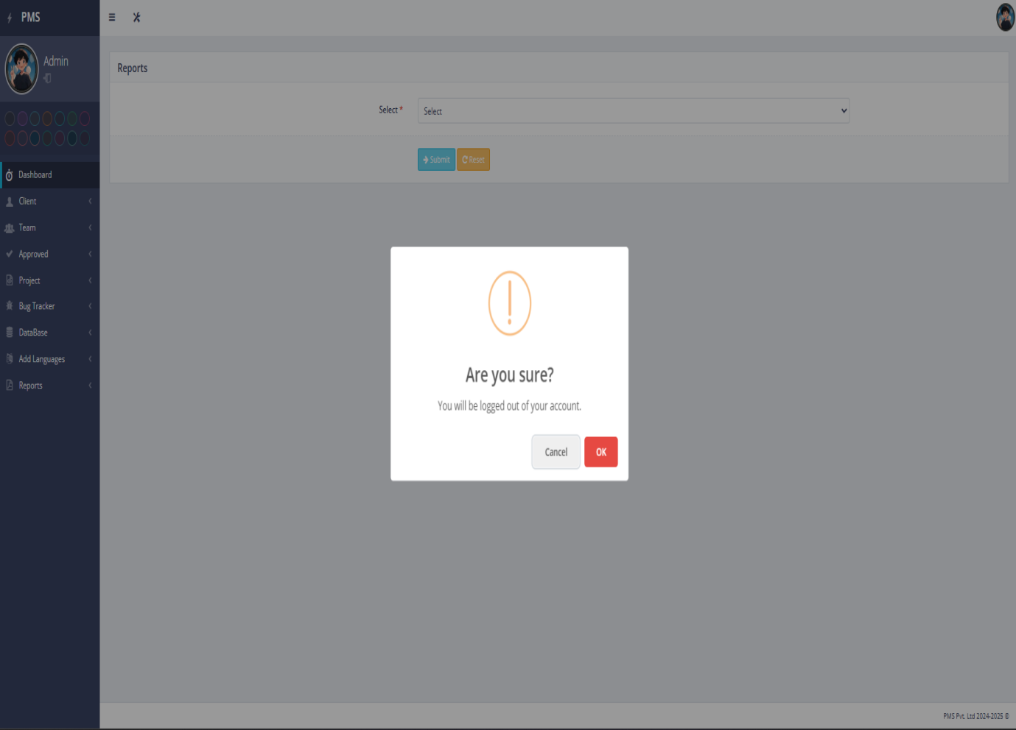
Logout

Slide 62
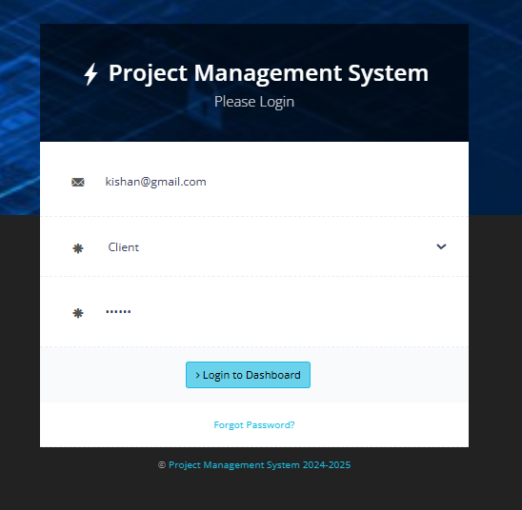
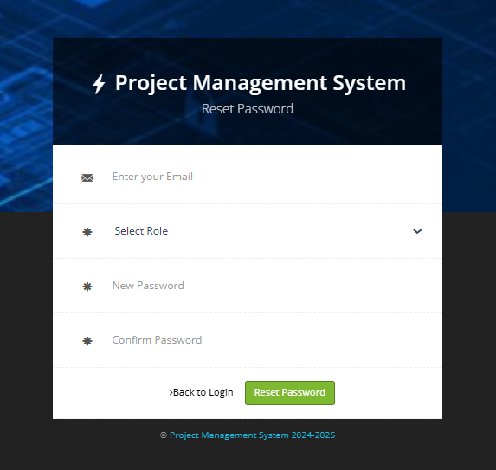
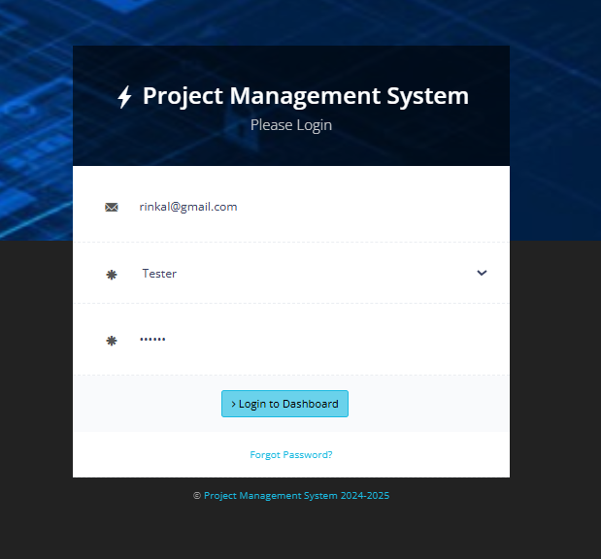
Client Design
Client Login :
Reset Password

Slide 63
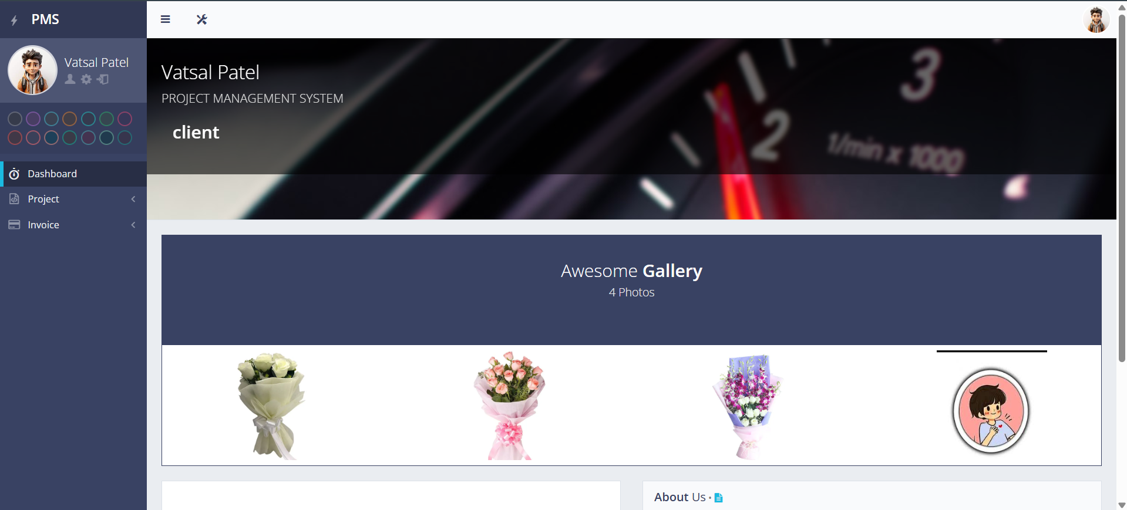
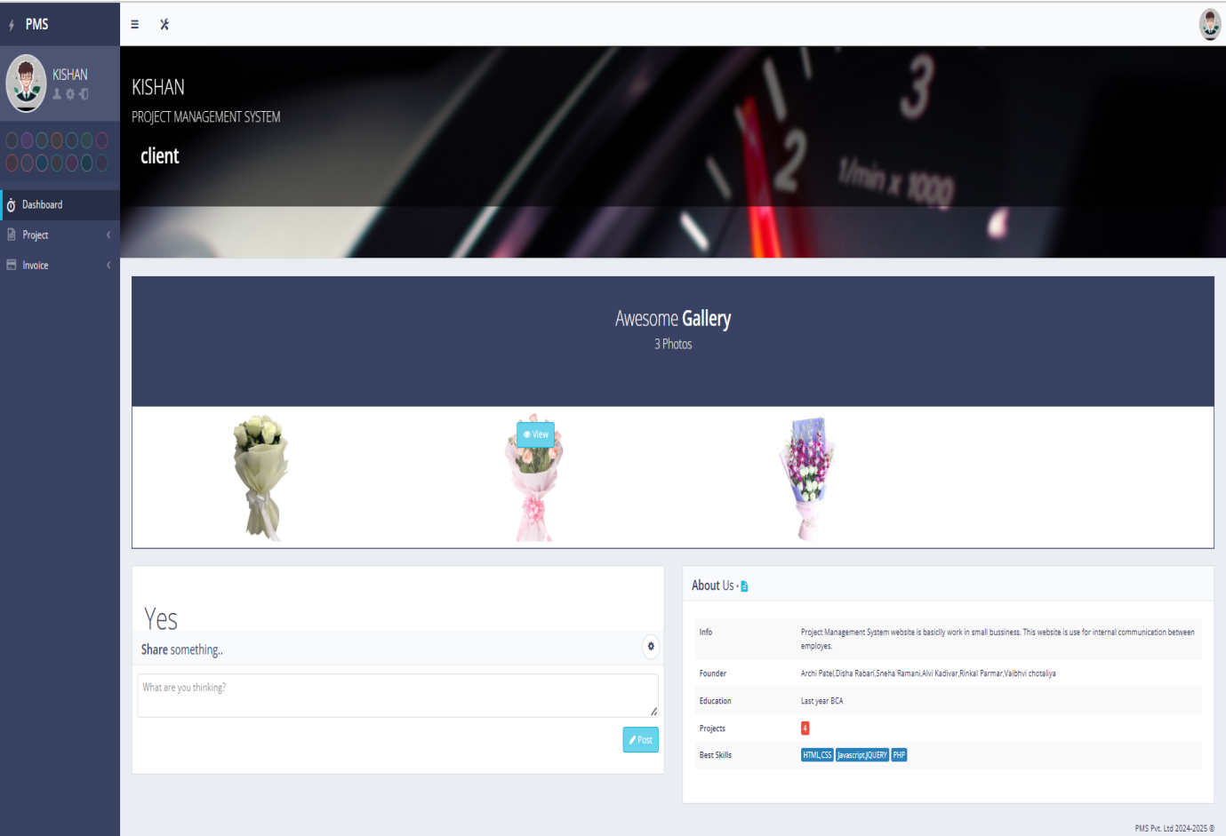
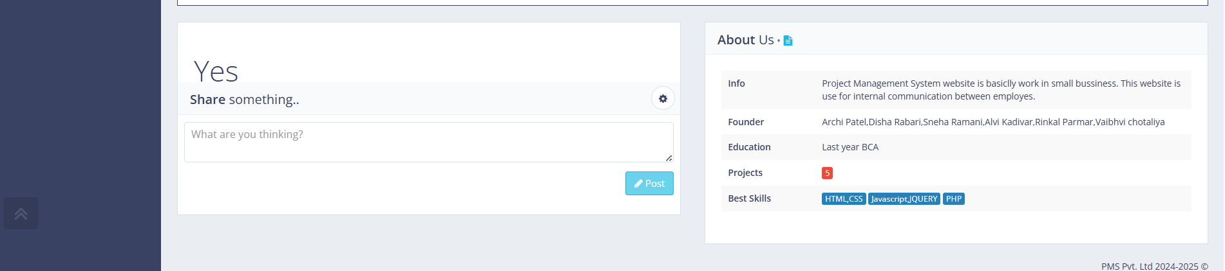
Client dashboard :

Slide 64
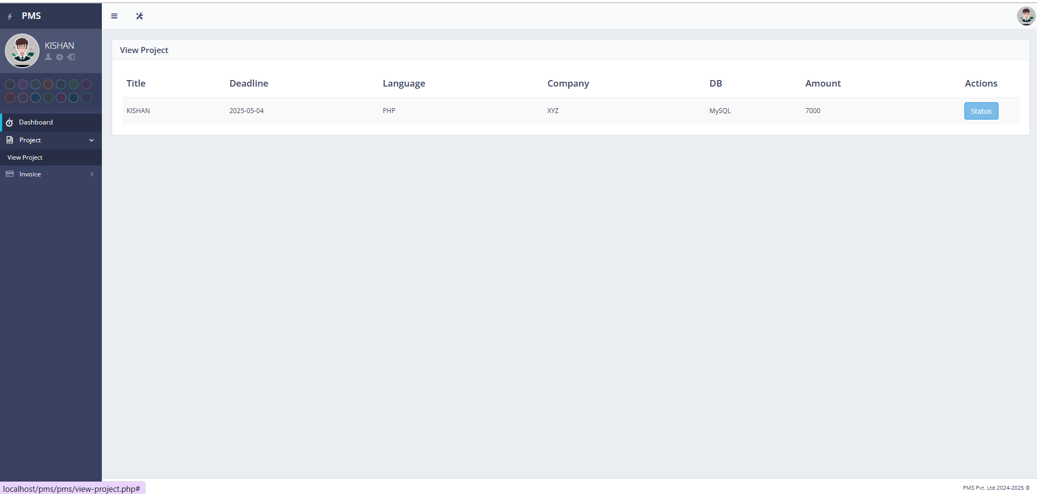
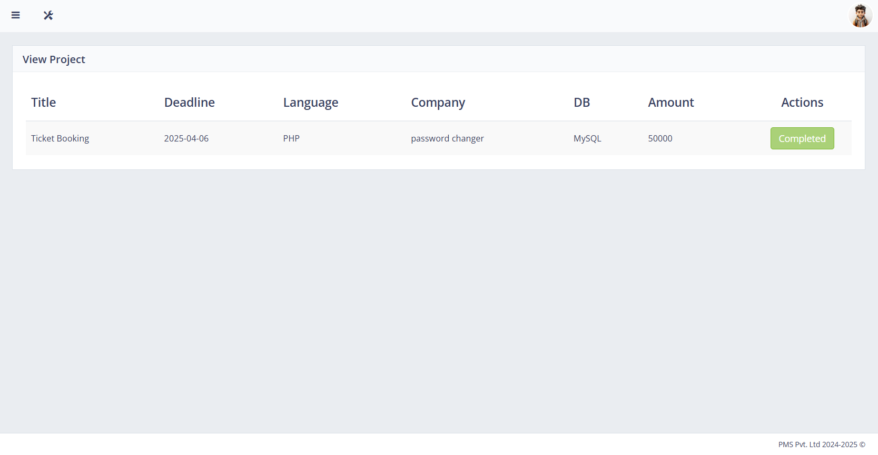
View Project :

Slide 65
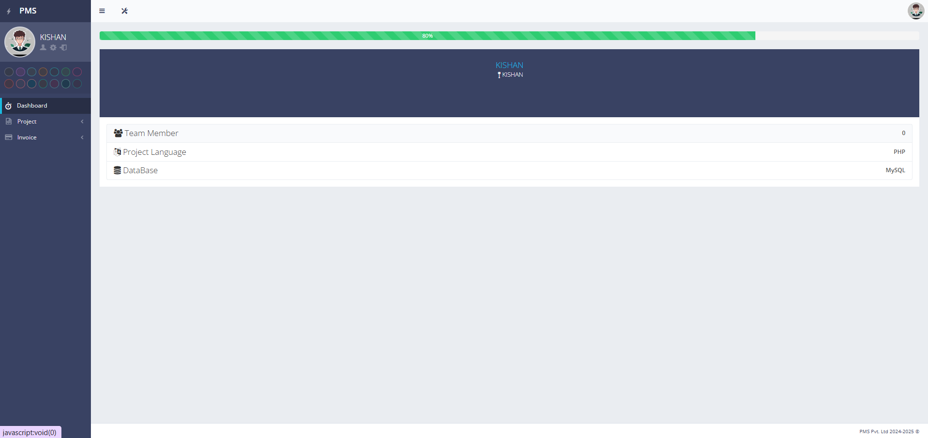
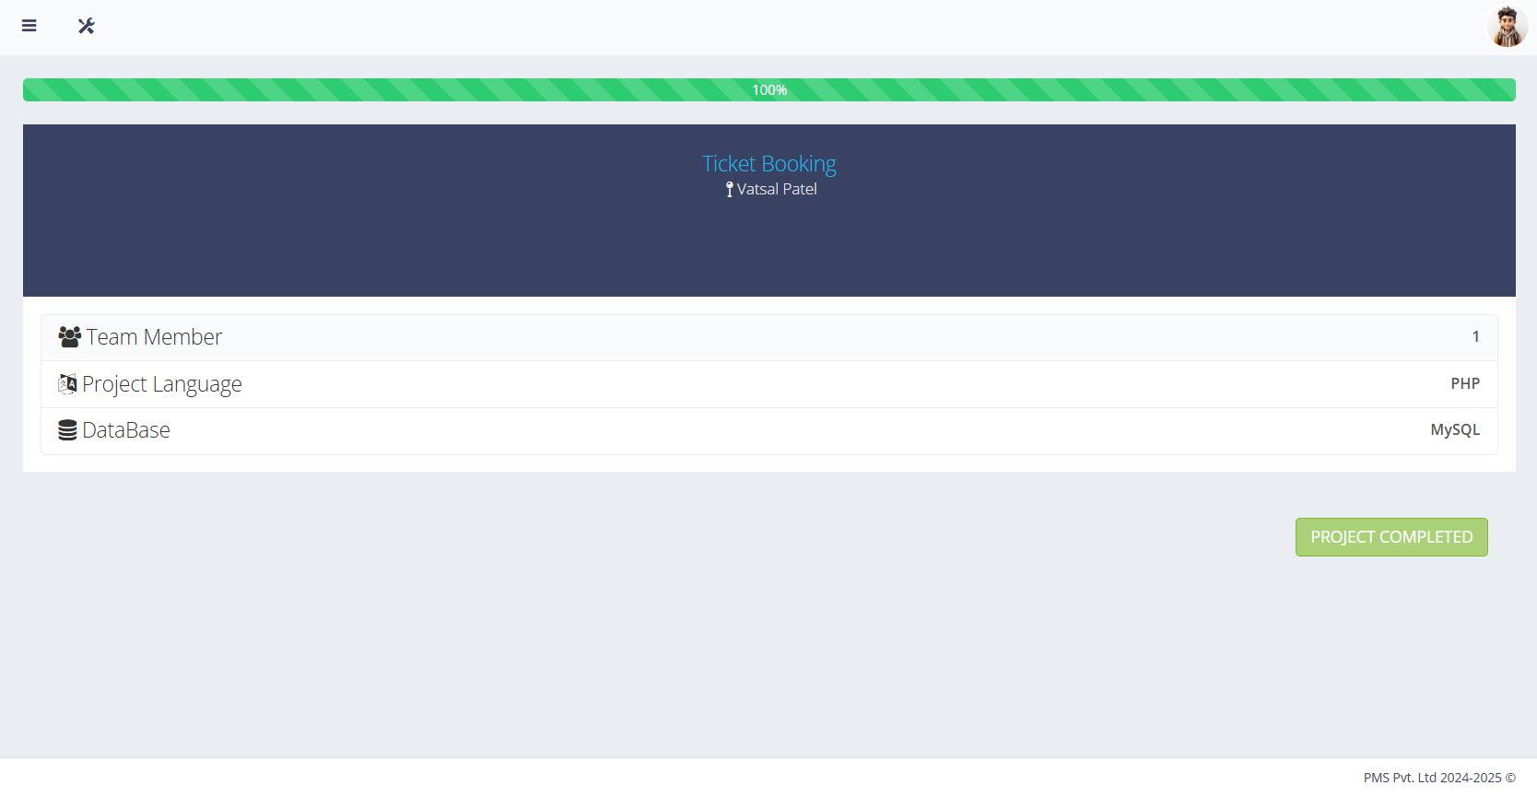
Check status :

Slide 66
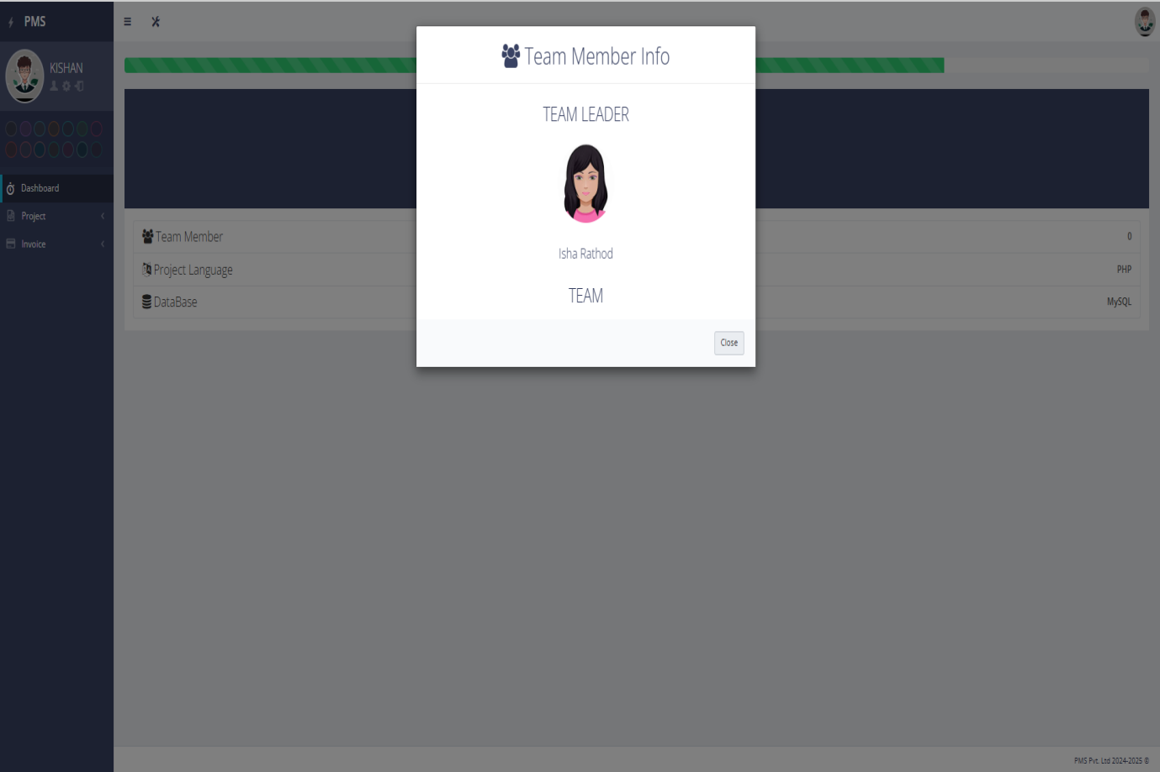

View Team leader

Slide 67

View Profile

Slide 68


Invoice

Slide 69



Slide 70

Logout

Slide 71

Teamleader/Team Design
TeamLeader Login

Slide 72

TeamLeader Dashboard

Slide 73

Update profile

Slide 74

Chat

Slide 75

View Project

Slide 76

Check status :

Slide 77

View team member

Slide 78

View/Closed Bug

Slide 79

Logout

Slide 80
Tester Design
Tester Login
Reset Password

Slide 81

Tester Dashboard

Slide 82

View/Update Profile

Slide 83


View Language/Database

Slide 84


View Total Members

Slide 85

View project

Slide 86

Check/Update Status

Slide 87


Add/Modify Bug

Slide 88


Chat

Slide 89

Setting

Slide 90

LogOut

Slide 91
6. Drawbacks
No Real-Time Notifications
Limited Messaging System
No Mobile Application
No API Integration
Basic Reporting System

Slide 92
7. Future Inhencement
Real-Time Notifications
Advanced Messaging System
Mobile Application Support
Third-Party API Integration
Automated Task Prioritization
Enhanced Reporting & Analytics
Multi-Language Support

Slide 93
8. Reference
https://getbootstrap.com/
https://www.w3schools.com/jquery/
https://www.w3schools.com/js/js_ajax_intro.asp
https://github.com/
https://www.geeksforgeeks.org/php-tutorials/
https://stackoverflow.com//

Slide 94
Thank
You

